Slide 1
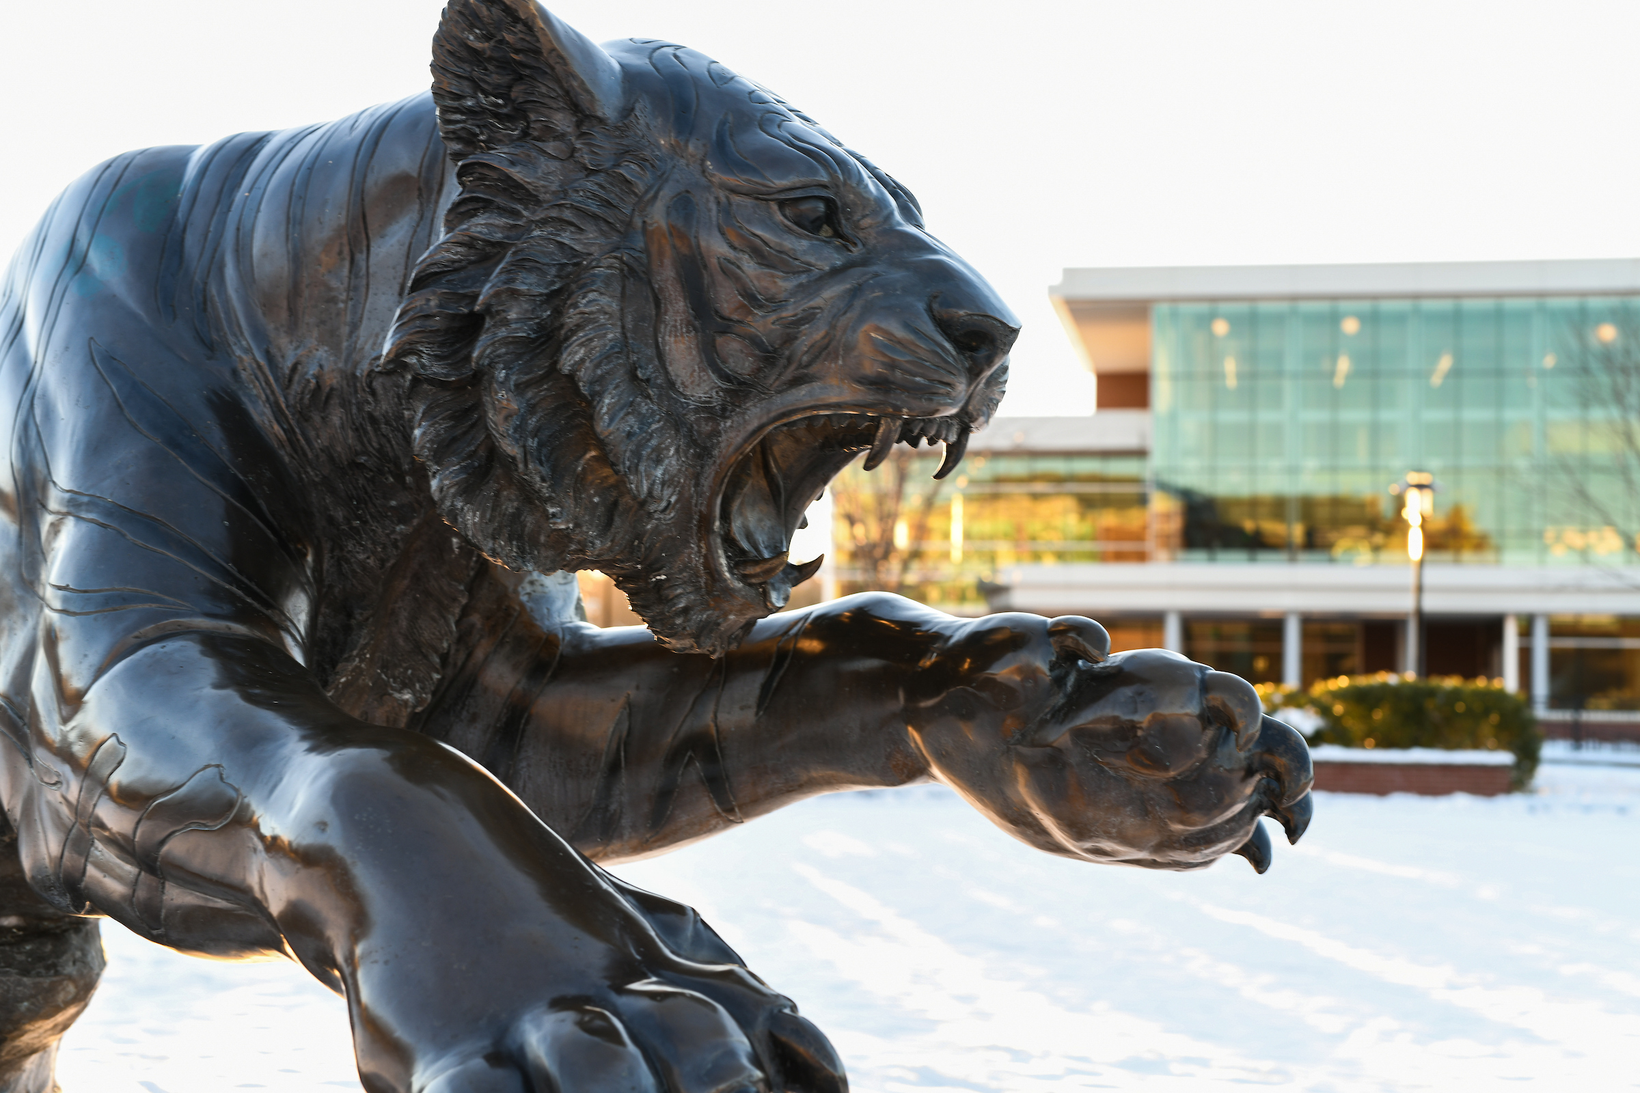

NSF Faculty Early Career Development Program (CAREER)
NSF 22-586: Due July 22, 2026

Slide 2
Overview
Due: July 22, 2026
Five years, start 6-9 months after deadline
Directorates for Biological Sciences, Engineering, and Office of Polar Programs total a minimum of $500,000.
All other Directorates total a minimum of $400,000
Project title must begin with “CAREER:”
Foundation-wide and one of NSF’S most prestigious awards
Integration of Research and Education/Outreach is Key—Intersection of research, education, and career development in the context of the organization.
PI Eligibility
Doctoral degree in a field supported by NSF
Engaged in research in an area of science, engineering, or education supported by NSF
Hold at least a 50% tenure-track (or tenure-track-equivalent) position as an assistant professor (or equivalent title)
Untenured
No previous CAREER awards
Three attempts
No Co-PIs permitted.
Office of Sponsored Programs & Research

Slide 3
Routing – Minimum One Week Ahead of Submission
Notify your chair & dean to discuss individual dept/college expectations.
Does your project require collaboration with another institution?
YES
Project title
Names & Roles of all TU Personnel (PI, Key Personnel)
Project start/end dates
3-5 sentence internal abstract
Project Description DRAFT
Final Budget & Budget Justification
Be mindful of your timeline! Your partner will also need to adhere to their institution’s internal routing processes.
If a subaward routing must include:
Final Subaward Budget & Budget Justification/Written Cost Proposal
Scope of Work
Subrecipient Commitment Form
Office of Sponsored Programs & Research

Slide 4
CAREER Timeline
Contact Subrecipients
Due to OSPR
Route: One Week
Final Budget
Submit: 7/21
OSPR aims to submit a day early in case of Research.gov technical errors
Project Description Draft
Sub Docs (if applicable)
OSPR will review and request revisions, as needed
Senior Personnel Docs
OSPR to OSPR
Budget Limit
Project title
Project dates
Subaward/Link
OSPR MAY STAGGER SUBMISSIONS IF THERE ARE MANY CAREER PROPOSALS.
Office of Sponsored Programs & Research

Slide 5
Proposal Components
REQUIRED DOCS
Project Summary (1 page)
Project Description (15 pages)
Broader Impacts
Results from Prior NSF Support
References Cited
Budget
Budget Justification (5 pages)
Facilities, Equipment & Other Resources
Senior Personnel Docs
Biosketch
CPS
COA
Synergistic Activities
Data Management Plan (2 pages)
Supplementary Documents
Departmental Letter (2 pages)
Should not be construed as a Letter of Support for the PI. Should address only the items in the solicitation.
OPTIONAL/CONDITIONAL DOCS
Mentoring Plan (1 page)
Letter(s) of Collaboration*
PECASE Eligibilty
Other Personnel Biographical Information (freeform)
*Letters of recommendation for the PI or other letters of support for the project are not permitted.
Office of Sponsored Programs & Research

Slide 6
Project Description: Goals and Objectives
Developing Project Objectives – Use the “Smart” Method:
Specific – be precise about what you hope to achieve
Measurable – quantify your objectives
Attainable – are you attempting too much? Feasibility is VERY important to reviewers.
Realistic – are you both able and willing to work toward this objective?
Timely – by when will the objectives be reached?
Office of Sponsored Programs & Research

Slide 7
Writing Tips
Link your project to relevant literature and the larger institutional context (strategic plan)
Make your proposal reviewer friendly
Visually appealing—use italics, color, bold, tables, bullets, images to break up blocks of text and emphasize important points
Explicit organization and headers
Cross-reference, label, and number everything
Remember that the reviewer doesn’t know you or your institution
Write your support portions as you are developing your proposal during down times and when you’re stuck (often leads to brainstorms)
Data management plan, evaluation plan, personnel docs, etc.
NO URLs within the Project Description!
Office of Sponsored Programs & Research

Slide 8
Budget and Budget Justification
Essential that the budget aligns with the narrative
The budget justification should back-up the narrative (i.e., it should not be the first instance budget elements are mentioned).
Purpose is clarity and calculations, not in-depth explanation of how funds will be spent.
Projection with intention & thoughtfulness
Wish List: OSPR wants to know everything you want and need for this project.
CAREER Awards for proposals to the Directorate for Computer & Information Science & Engineering are expected to support:
One month of PI salary/year
One graduate student/year
Two trips/year
Before preparing a CAREER proposal, PIs are strongly encouraged to contact their disciplinary Program Officer or the appropriate CAREER contact to discuss budget requests for their proposed CAREER activities, and typical funding levels for their discipline. Many programs and Directorates prefer to make more awards by funding CAREER proposals closer to the minimum award size. Proposers should also review the list of recent CAREER awards made in their discipline for guidance on average award size.
Office of Sponsored Programs & Research

Slide 9
Personnel Costs
Faculty | Non-Faculty
Summer/Supplemental Support 9-month faculty – 3-month limit Based on percentage of effort FICA – 8% Funds go to faculty member | Contingent I & II FICA – 8% Fringe Benefits – 27%
 | Hourly Students Undergrads or Graduates Hours, weeks, and hourly rate* *Discuss with your colleagues/department chair
Academic Effort/T-SAP 10% of 9-month contract salary Fringe Benefits – 39% Funds go back to department/college | Graduate Assistantship Schedule Full-time = 20 hours/week; 12 credits Part-time = 10 hours/week; 6 credits
Office of Sponsored Programs & Research

Slide 10
Non-Personnel Costs
Consultants | Materials & Supplies
Participant Support Costs Stipends Travel Subsistence | Travel Domestic & Foreign
Food Costs Generally, not allowable on federal awards Must be well-justified Must have an agenda Recoup indirect costs | Equipment Tangible, non-expendable property Useful life >1 year Per unit acquisition cost of >$5,000
Human Subject Costs | Publication Costs
Tuition Remission | Subawards
Computer Services Computer-based retrieval of scientific, technical, and educational information | Contracts for the purpose of obtaining goods and services for the proposer’s own use E.g., sample analysis by a vendor
Office of Sponsored Programs & Research

Slide 11
Current and Pending Support
Used by sponsors and reviewers to assess:
The capacity of the individual to carry out proposed research.
Any potential scientific and budgetary overlap or duplication across projects.
Potential the individual is overcommitting themselves with the proposed project.
NOT meant to be punitive.
What other support do you have in place?
Active Awards—including internal awards
Pending Proposals
Certain consulting activities
Certain in-kind effort
Certain oversight of postdocs, students, visiting scholars
Overcommitment
Funded commitment cannot exceed 100% of your time
Pending commitments can exceed 100% of your time
Full disclosure critical—senior/key personnel are required to certify that the information is current, accurate and complete.
Foreign support disclosure critical
Required Disclosures in NSF Proposals
SciENcv
Office of Sponsored Programs & Research

Slide 12
Presidential Early Career Award for Scientists and Engineers (PECASE)
Each year NSF selects nominees for the Presidential Early Career Awards for Scientists and Engineers (PECASE) from among the most meritorious recent CAREER awardees.
Selection for this award is based on two important criteria:
Performance of innovative research at the frontiers of science, engineering, and technology that is relevant to the mission of the sponsoring organization or agency;
Community service demonstrated through scientific leadership, education or community outreach.
PECASE Eligibility
U.S. Citizen
U.S. National
U.S. Permanent Resident by the time of nomination
Office of Sponsored Programs & Research

Slide 13
Required Trainings
Responsible & Ethical Conduct of Research Training
All NSF-supported personnel (PIs, Co-PIs, other senior/key personnel, other professionals, including students engaging in research activities) must complete RECR training.
The OSPR recommends that faculty members complete the training after they submit a proposal so that the requirement is met upon award.
Students must complete training before they can be paid.
PIs are responsible for ensuring that students and other personnel complete the training requirement.
Research Security Training
All senior/key personnel must complete RST before the NSF proposal can be submitted.
TU offers training that complies with both requirements through the Collaborative Institutional Training Initiative (CITI).
Office of Sponsored Programs & Research

Slide 14
Questions?
Office of Sponsored Programs & Research
Rebecca O’Brien, Assistant Vice President
Anne Greene, Associate Director, Pre-Award Services
Kat Nunan, Senior Grant & Contract Administrator
Braden Burns, Grant & Contract Specialist
Corinne Kirby, Grant & Contract Specialist
Other Resources
Solicitation: NSF 22-586
Proposal & Award Policies & Procedures (PAPPG) NSF 24-1
OSPR Proposal Development
OSPR Budget Development
Office of Sponsored Programs & Research

