Slide 1


Harford County Public Schools Application, Interview, and Hiring Practice
Shannon Hagan
Coordinator of Staff Management

Slide 2

The Application
Complete application at www.hcps.org
Avoid “see resume”
Avoid abbreviations
2022-23 SY applications will be available in February
Requirements:
3 professional references
Attach test scores, transcripts, and certification
(if available)

Slide 3

The Interview
Elementary/Early Childhood – 2 step process
Secondary/Specific Content Area – 3 step process
Human Resources Screening:
General questions about lesson planning, classroom management, assessment, parent communication, and cultural proficiency
Recorded Video Option
Content Area:
Specific content questions
School Interview:
Varies by principal
Professional dress is a must!
Portfolios are optional

Slide 4

Alternative Interview for HCPS Interns
Invite a member of the administrative team to observe a lesson in lieu of an interview.
Complete by April 30th if possible for Spring Graduates
Complete by 12/1 for December Graduates
Lesson observations will be similar to those conducted on HCPS teachers, using the Danielson Framework.
Domain 1: Planning and Preparation
Domain 2: Classroom Environment
Domain 3: Instruction
Domain 4: Professional Practice
An online application must be submitted for the observation to be valid.

Slide 5

The Hiring Process
Application completed
All required interviews completed
Interviews expire after one year
Principal makes selection and alerts Human Resources
Human Resources verifies all documentation has been received:
Transcripts with degree conferral, test scores, and certification if applicable
Completed references are required from mentor teacher(s) and university supervisor.
Human Resources makes the offer
You will have 24 hours to accept the offer

Slide 6
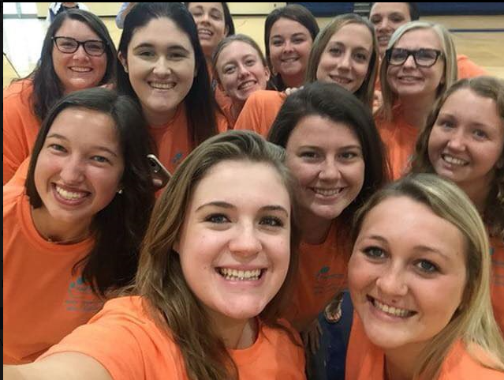
Open Contracts
HCPS will offer open contracts to candidates who exceed expectations and for positions in which there are known vacancies.
This will guarantee a position with HCPS.
The candidate will be given priority to interview with schools.
Candidate will select offer that they feel is a best fit.

Slide 7
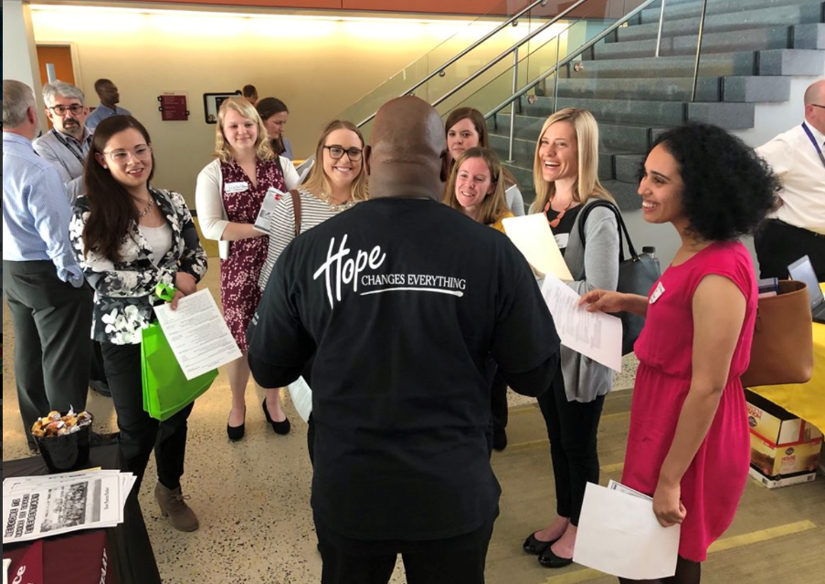
HCPS Teacher Expo
HCPS hosts a Teacher Expo in the early spring each year at Towson University Northeastern.
Stay tuned for details.

Slide 8
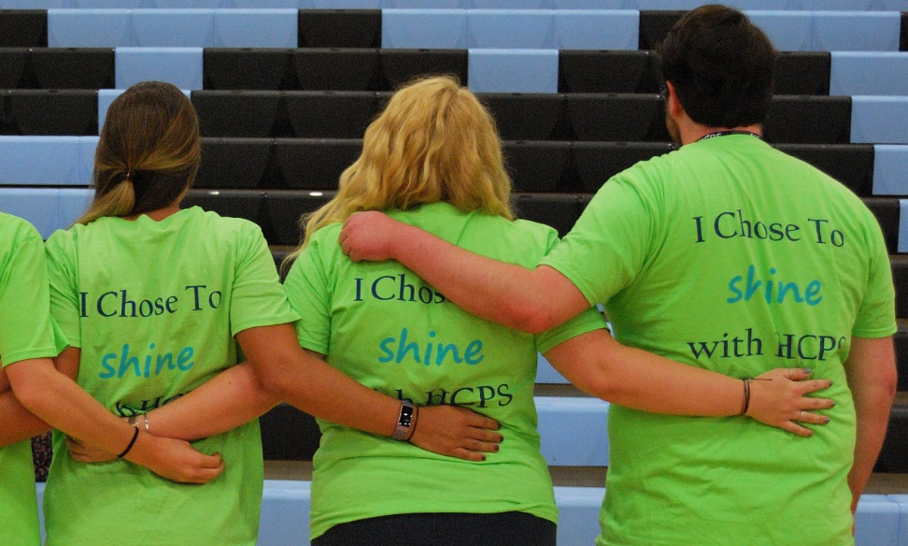
Salary and Benefits
In the top 5 highest salaries in MD
Starting salary for Bachelor’s degree for 21-22 SY $50649
Starting salary for Master’s degree for 21-22 SY $53661
HCPS covers 85-95% of your heath care. Our significant contribution will lessen the impact on your salary.
$900 for each 3-credit course is provided for tuition reimbursement as you work towards your Master’s Degree
Always ask counties about their benefits and tuition reimbursement package!

Slide 9



Social Media- Follow, Like, Share, Retweet
@HCPSRecruiter
#HCPSchoosetoshine
#HCPSshinebrighter
#HCPSshineon
#HCPScomeshine

Slide 10
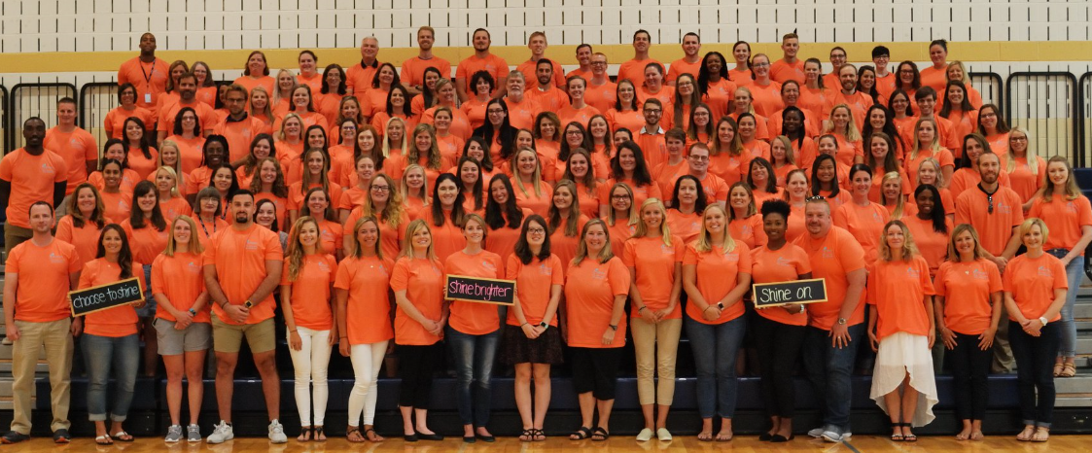
Do you see yourself here? We do! For more information email: Shannon.Hagan@hcps.org

