Slide 1
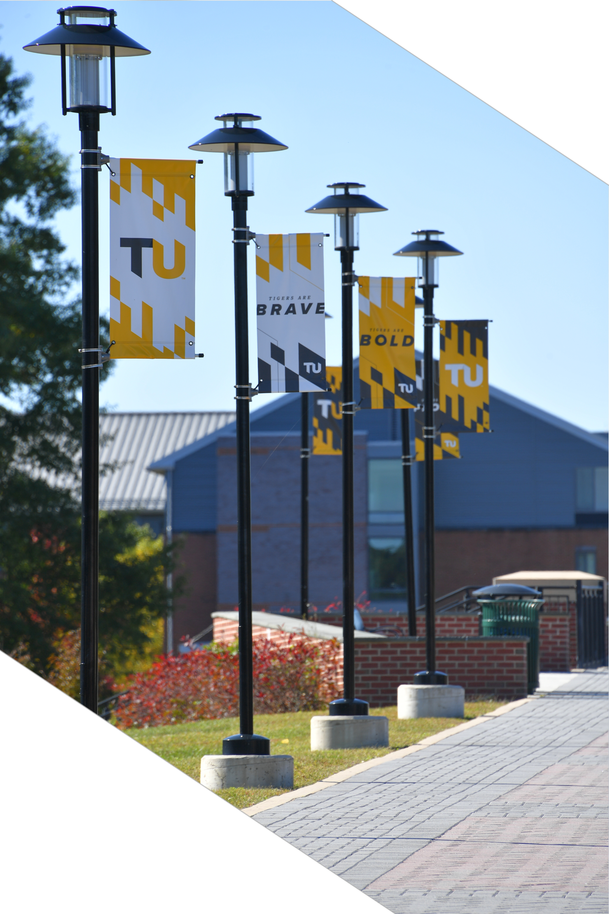

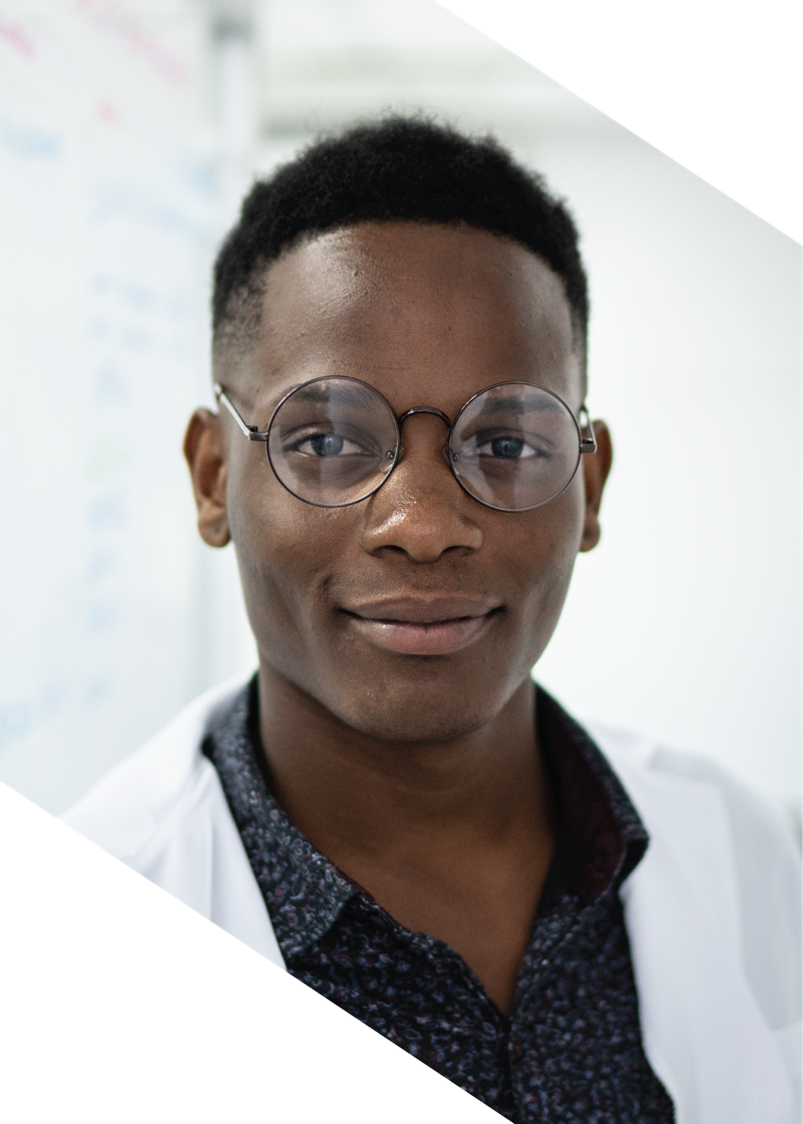


Masters of Arts in Dance Education
Towson University
Notes:
Welcome and thank you for joining me.

Slide 2
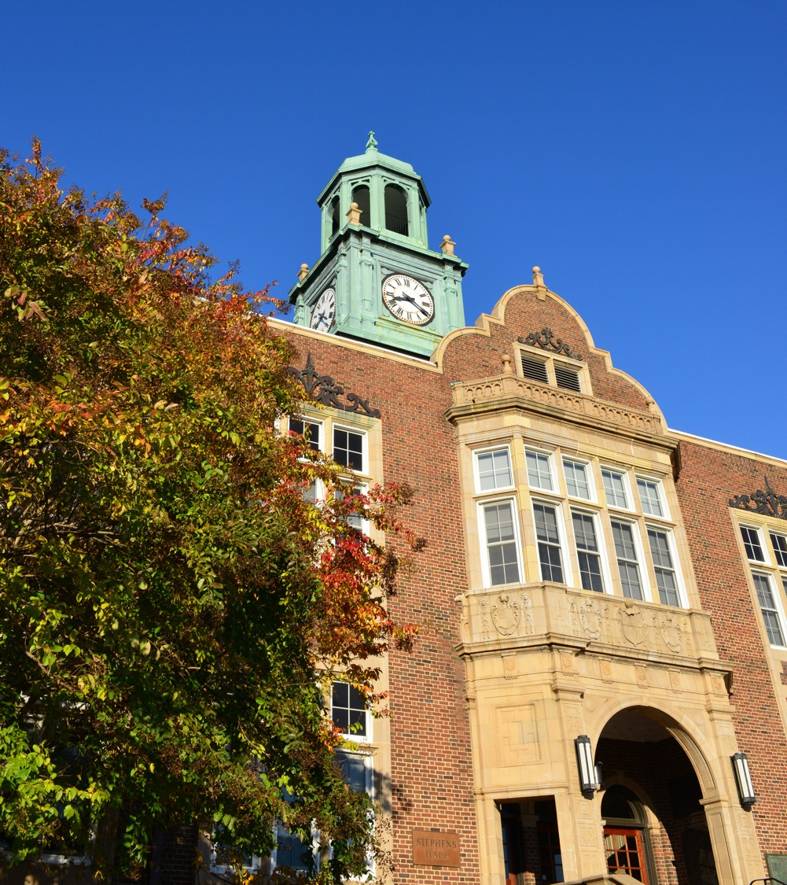

Welcome!
Jaye Knutson Professor, Dance
MA, Dance and Theatre
BS, Physical Education/Dance Concentration/Teacher Certification
Certificate in Laban Bartenieff Movement Analysis
Program Director

Slide 3
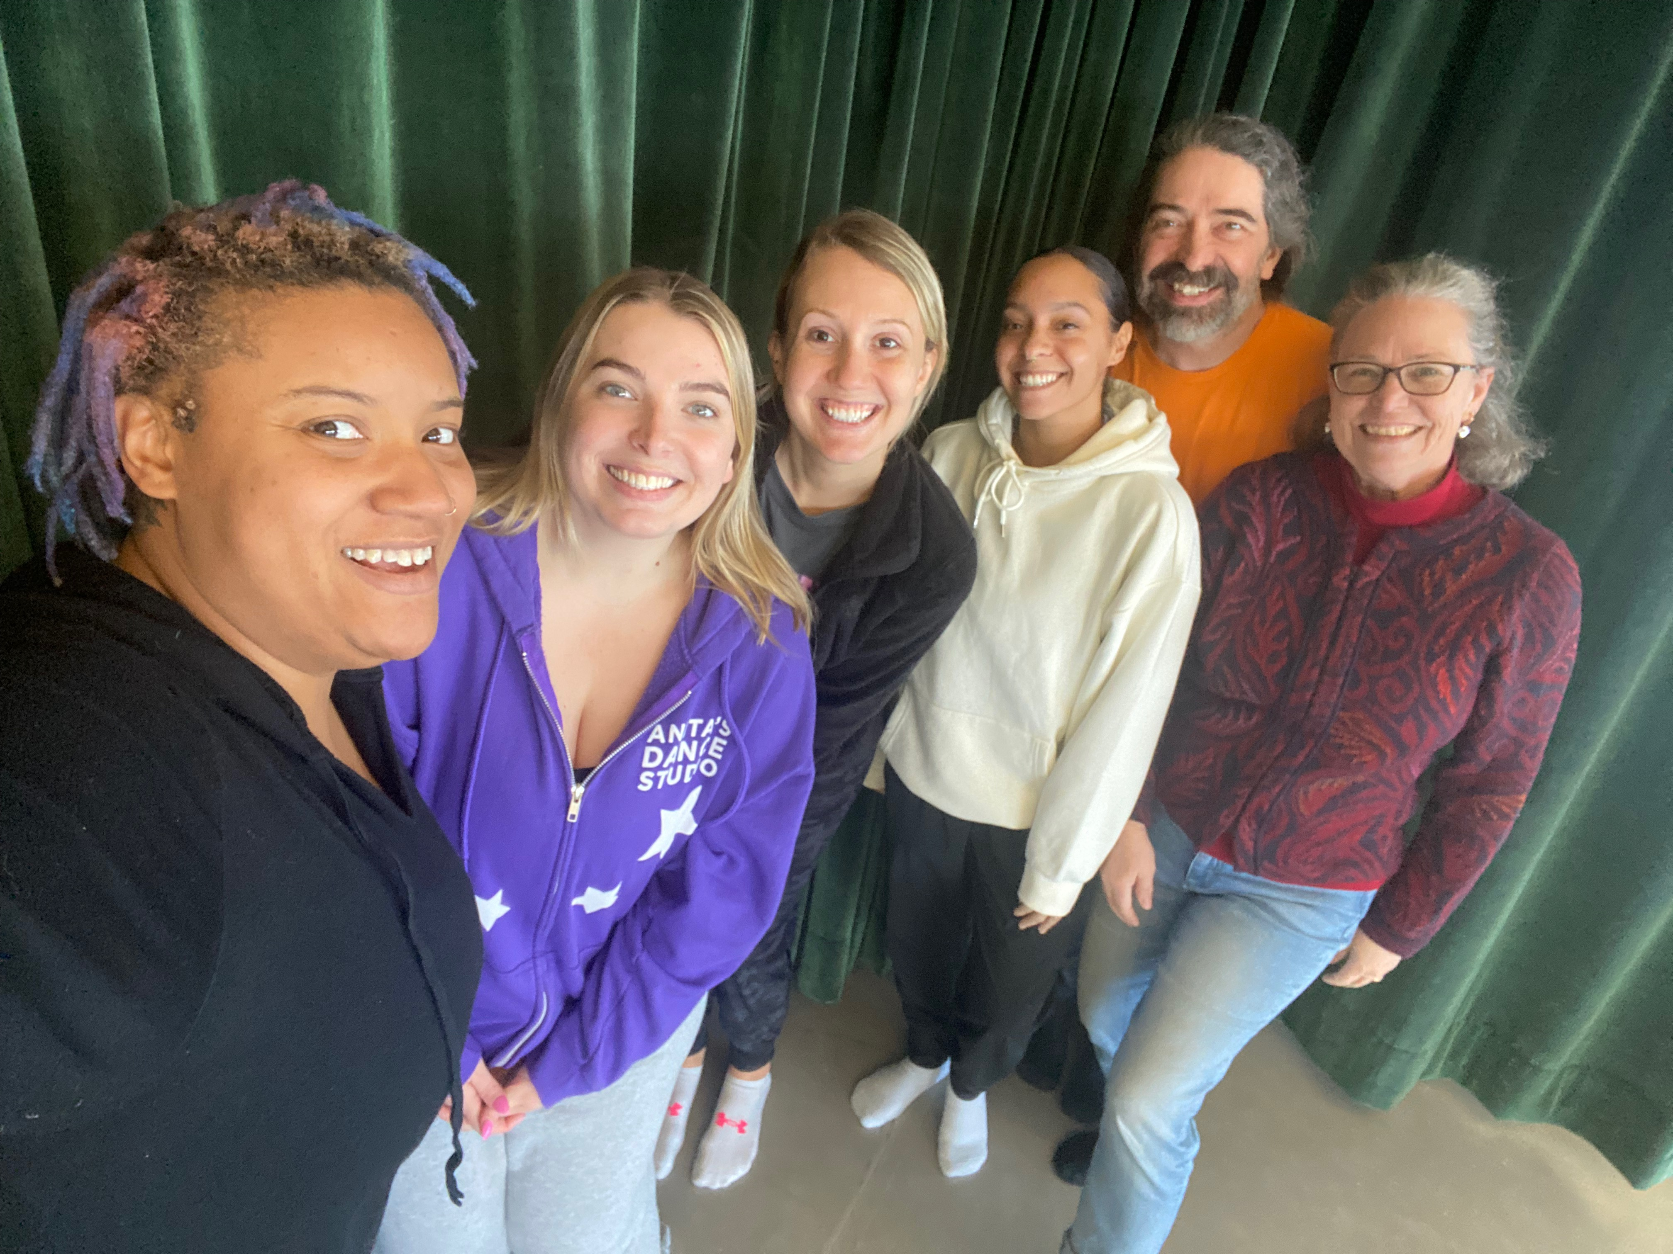

About TU
Largest university in the Baltimore area
80+ graduate degree programs
3,010 graduate students
Minority-majority institution
Research-intensive environment
Named No. 1 public university in Maryland
Named a top producer of Fulbright U.S. Students
Notes:
We are the largest University in the Baltimore Area
The Mid-Atlantic region offers many opportunities in: Government, Private, Non-profit, Education, Health, Finance, IT, Manufacturing, Consulting and the Arts​ ​
80+ Graduate Degree Programs​
-7 Doctoral​ -49 Masters​ -41 Certificates (Cert and CAS) ​
​
Minority-majority institution – diversity and inclusion are priorities for the university, and our student body reflects that.​
​​
No. 1 by The Wall Street Journal rankings​
US Department of State’s Bureau of Educational and Cultural Affairs recognized TU for being one of the colleges and universities with the highest number of students selected for the Fulbright US Student Program – We value global connection and support members of our campus community in their pursuit of international opportunities.

Slide 4
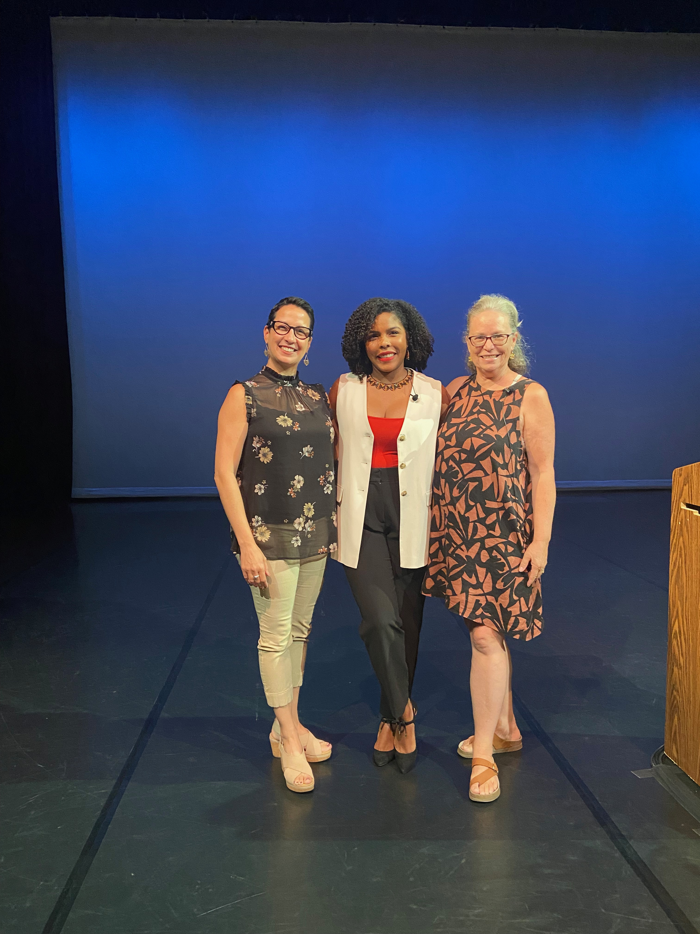
About Dance Education
Currently accepting candidate application.
2-year, 36 credit program of advanced study.
Flexible instructional formats accommodating the working dance professional.
Designed for the working dance professional who seeks to deepen their mastery in dance pedagogy.

Slide 5
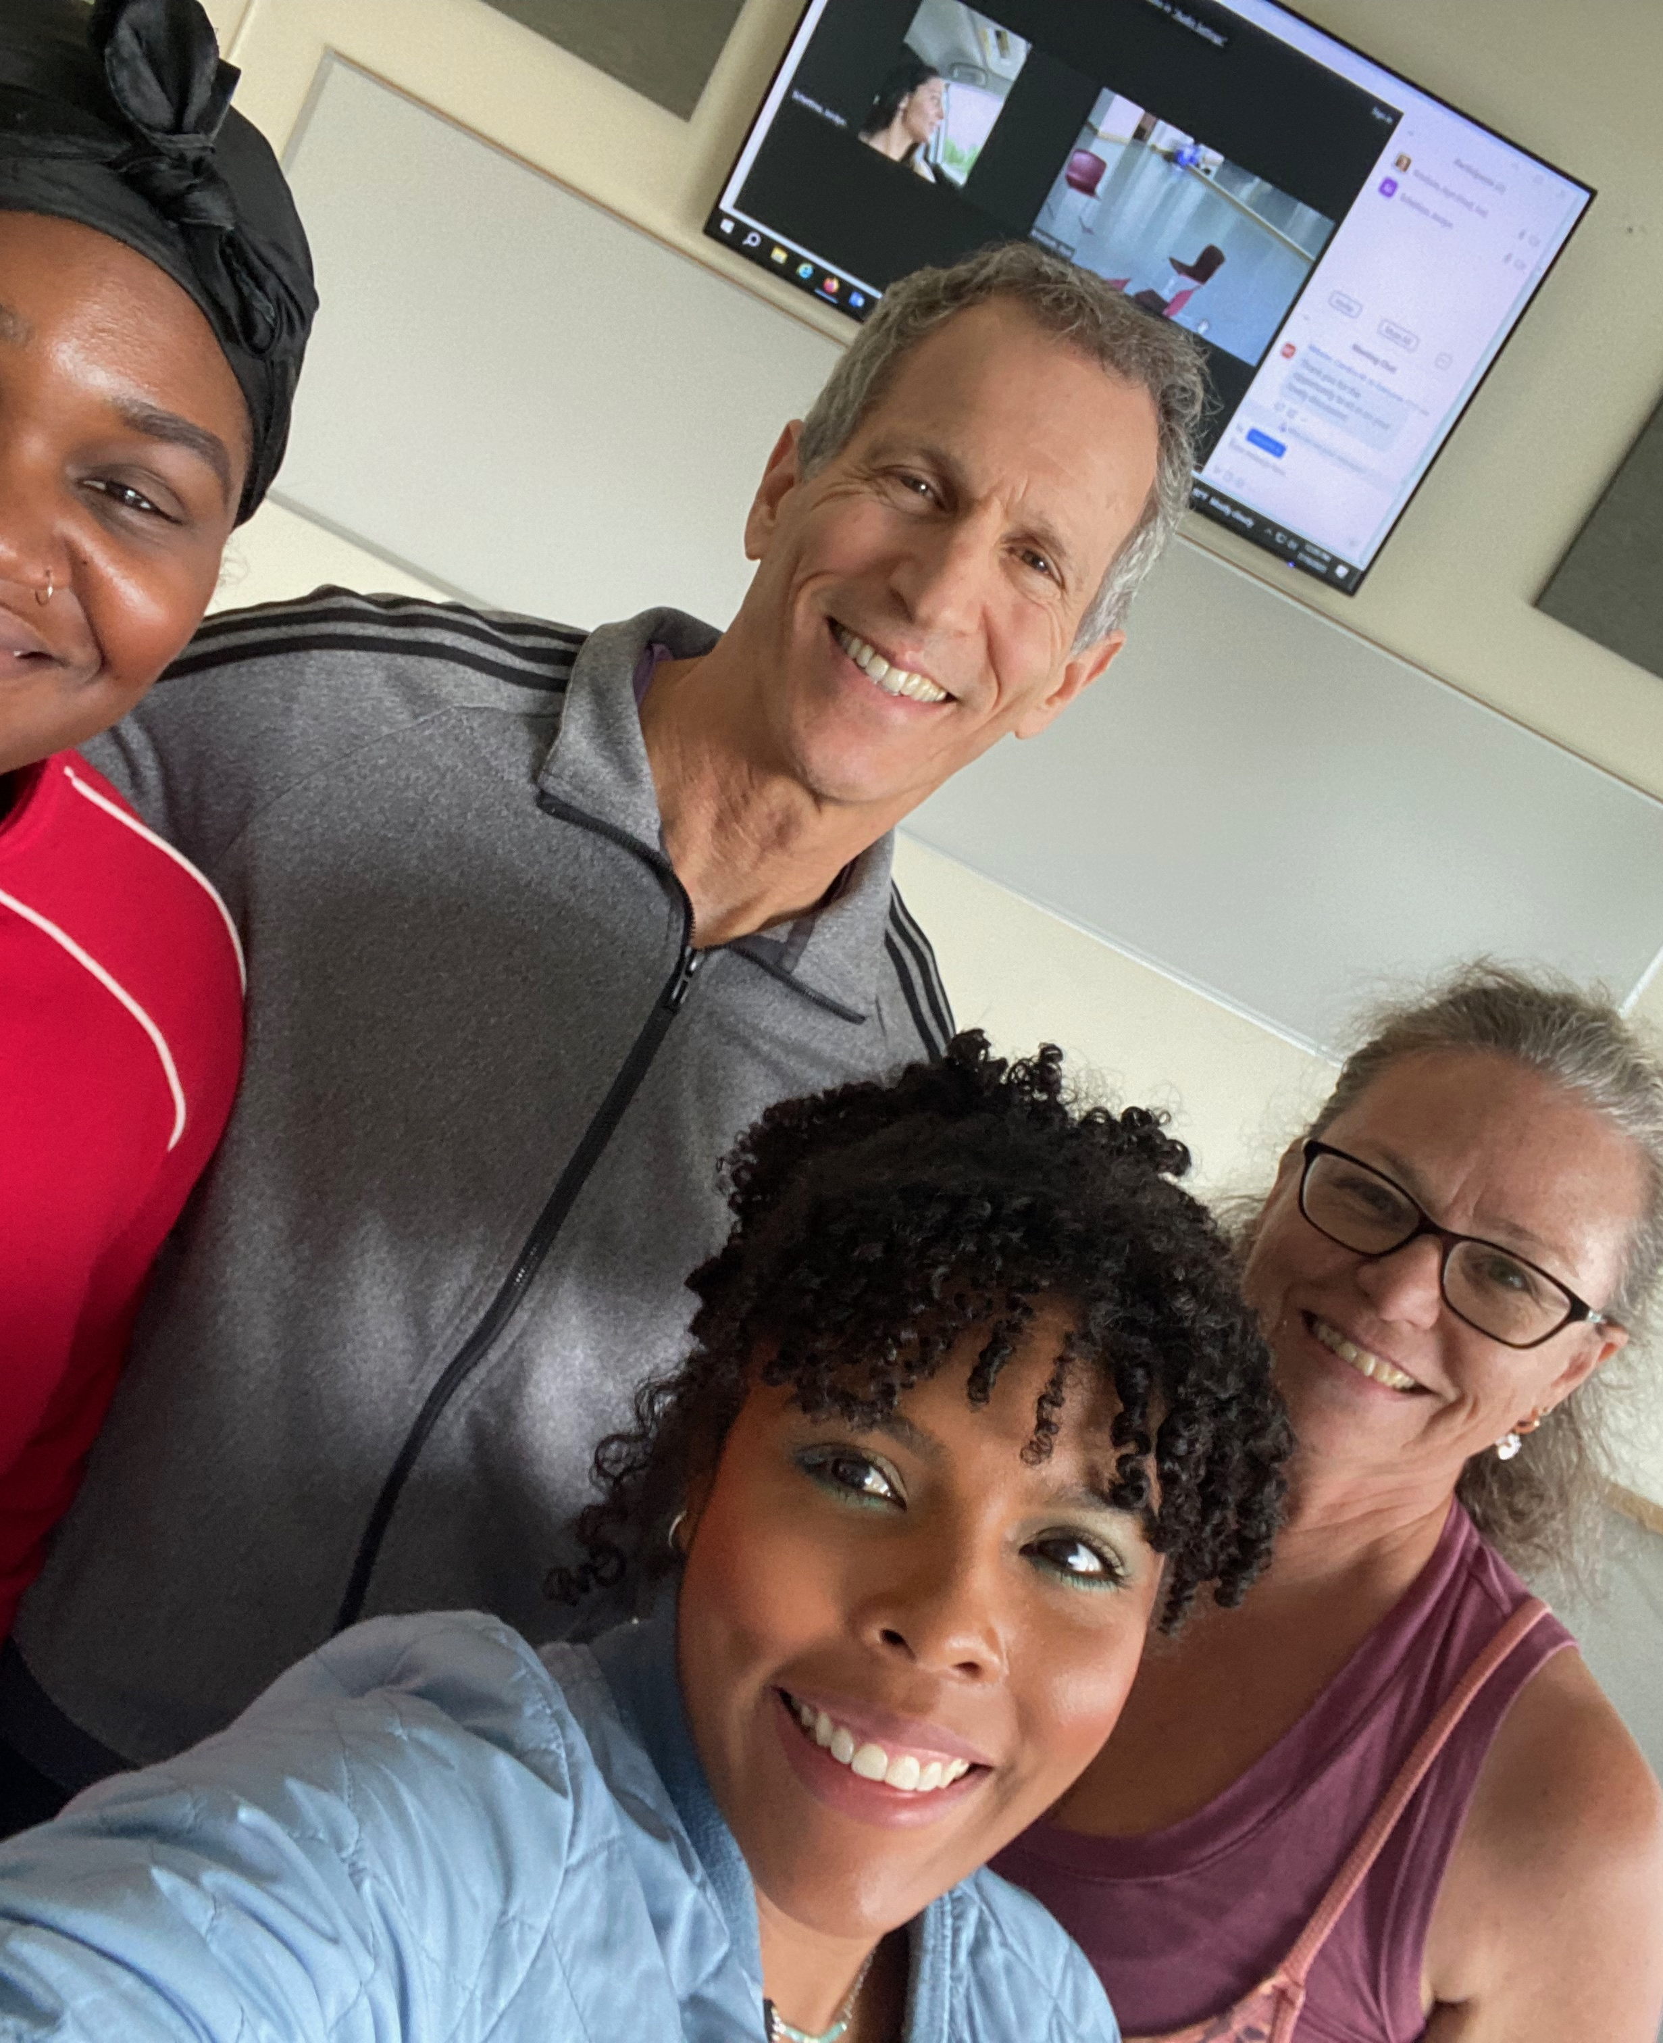
MADE was designed for….
The state certified dance educator securing the master’s credential for advanced licensure.
The dance professional seeking to deepen their teaching practice.

Slide 6
Program Highlights
Work independently and collaboratively within a small, diverse cohort of dance professionals over a period of 2 years
Complete a common core of required courses and an individualized sequence of elective courses
Identify, propose, execute & report on a specific research interest of action research
Resource a distinguished community of dance master teachers to inform and support your action research
Work within a small, diverse cohort of dance professionals
Disseminate the results of your action research thesis in an open seminar

Slide 7


Cohort 4
Program Beginning Summer 2025
2nd 5-week summer session (July 2 – August 6)
Social Media
JOHNY COFFEE

Slide 8
Program Curriculum Sequencems
Summer 2025 | DANC370 | Intro to LBMA (Prerequisite)
 | DANC600 | Global Pedagogy
 | #MCRED Milestone | Learning Through the Creative Process
Fall 2025 | IDFA703 | Interdisciplinary Research Methods
Winter 2026 | DANC700 | Culture of the Lived Body
Spring 2026 |  | Elective 1 Elective 2
Summer 2026 | DANC745 | Personal Pedagogy: Embodied Practice
 | DANC845 | Action Research in Pedagogical Inquiry
Fall 2026 | DANC896/8 | Elective 3 Thesis (2)
Winter 2027 |  | Elective 4
Spring 2027 | IDFA609 DANC896/8 | Arts Integration Capstone Thesis (2) or (3) Elective 4
Summer 2027 | DANC896/8 | Thesis (2) or (3)
 |  | Thesis Presentation & Oral Defense
December 2027 |  | Graduation Commencement

Slide 9
APPLYING TO TU
Social Media
JOHNY COFFEE

Slide 10
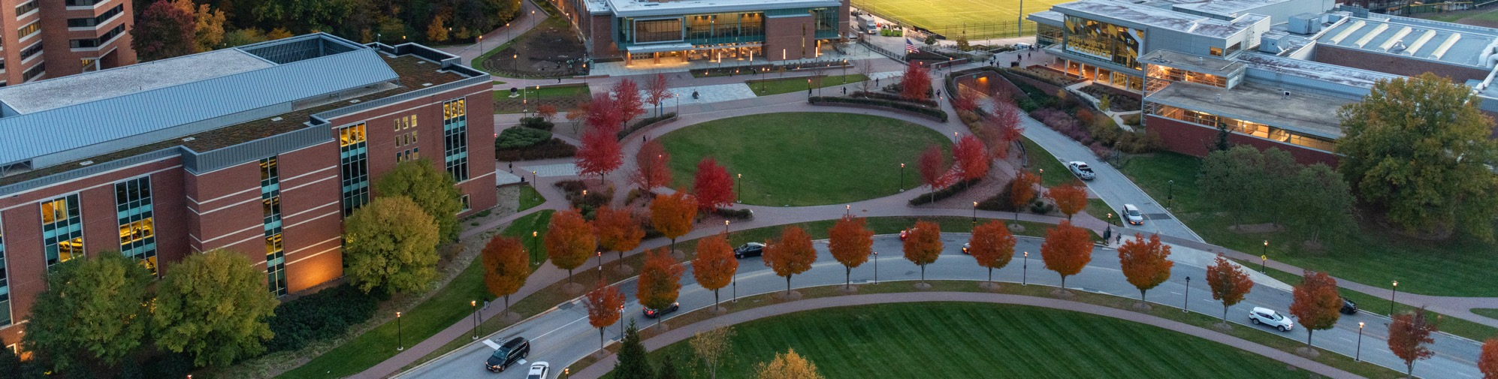
Application Deadlines
Summer
Priority Deadline: January 15
Final Deadline: May 1
Notes:
Rolling Review of Applications begin
www.towson.edu/gradapply
$50 Application Fee
Fee Waiver Options
Graduate Studies Open House Attendance
TU Alums or current students
US Military Service
Recent applicant (within 1 academic year)

Slide 11
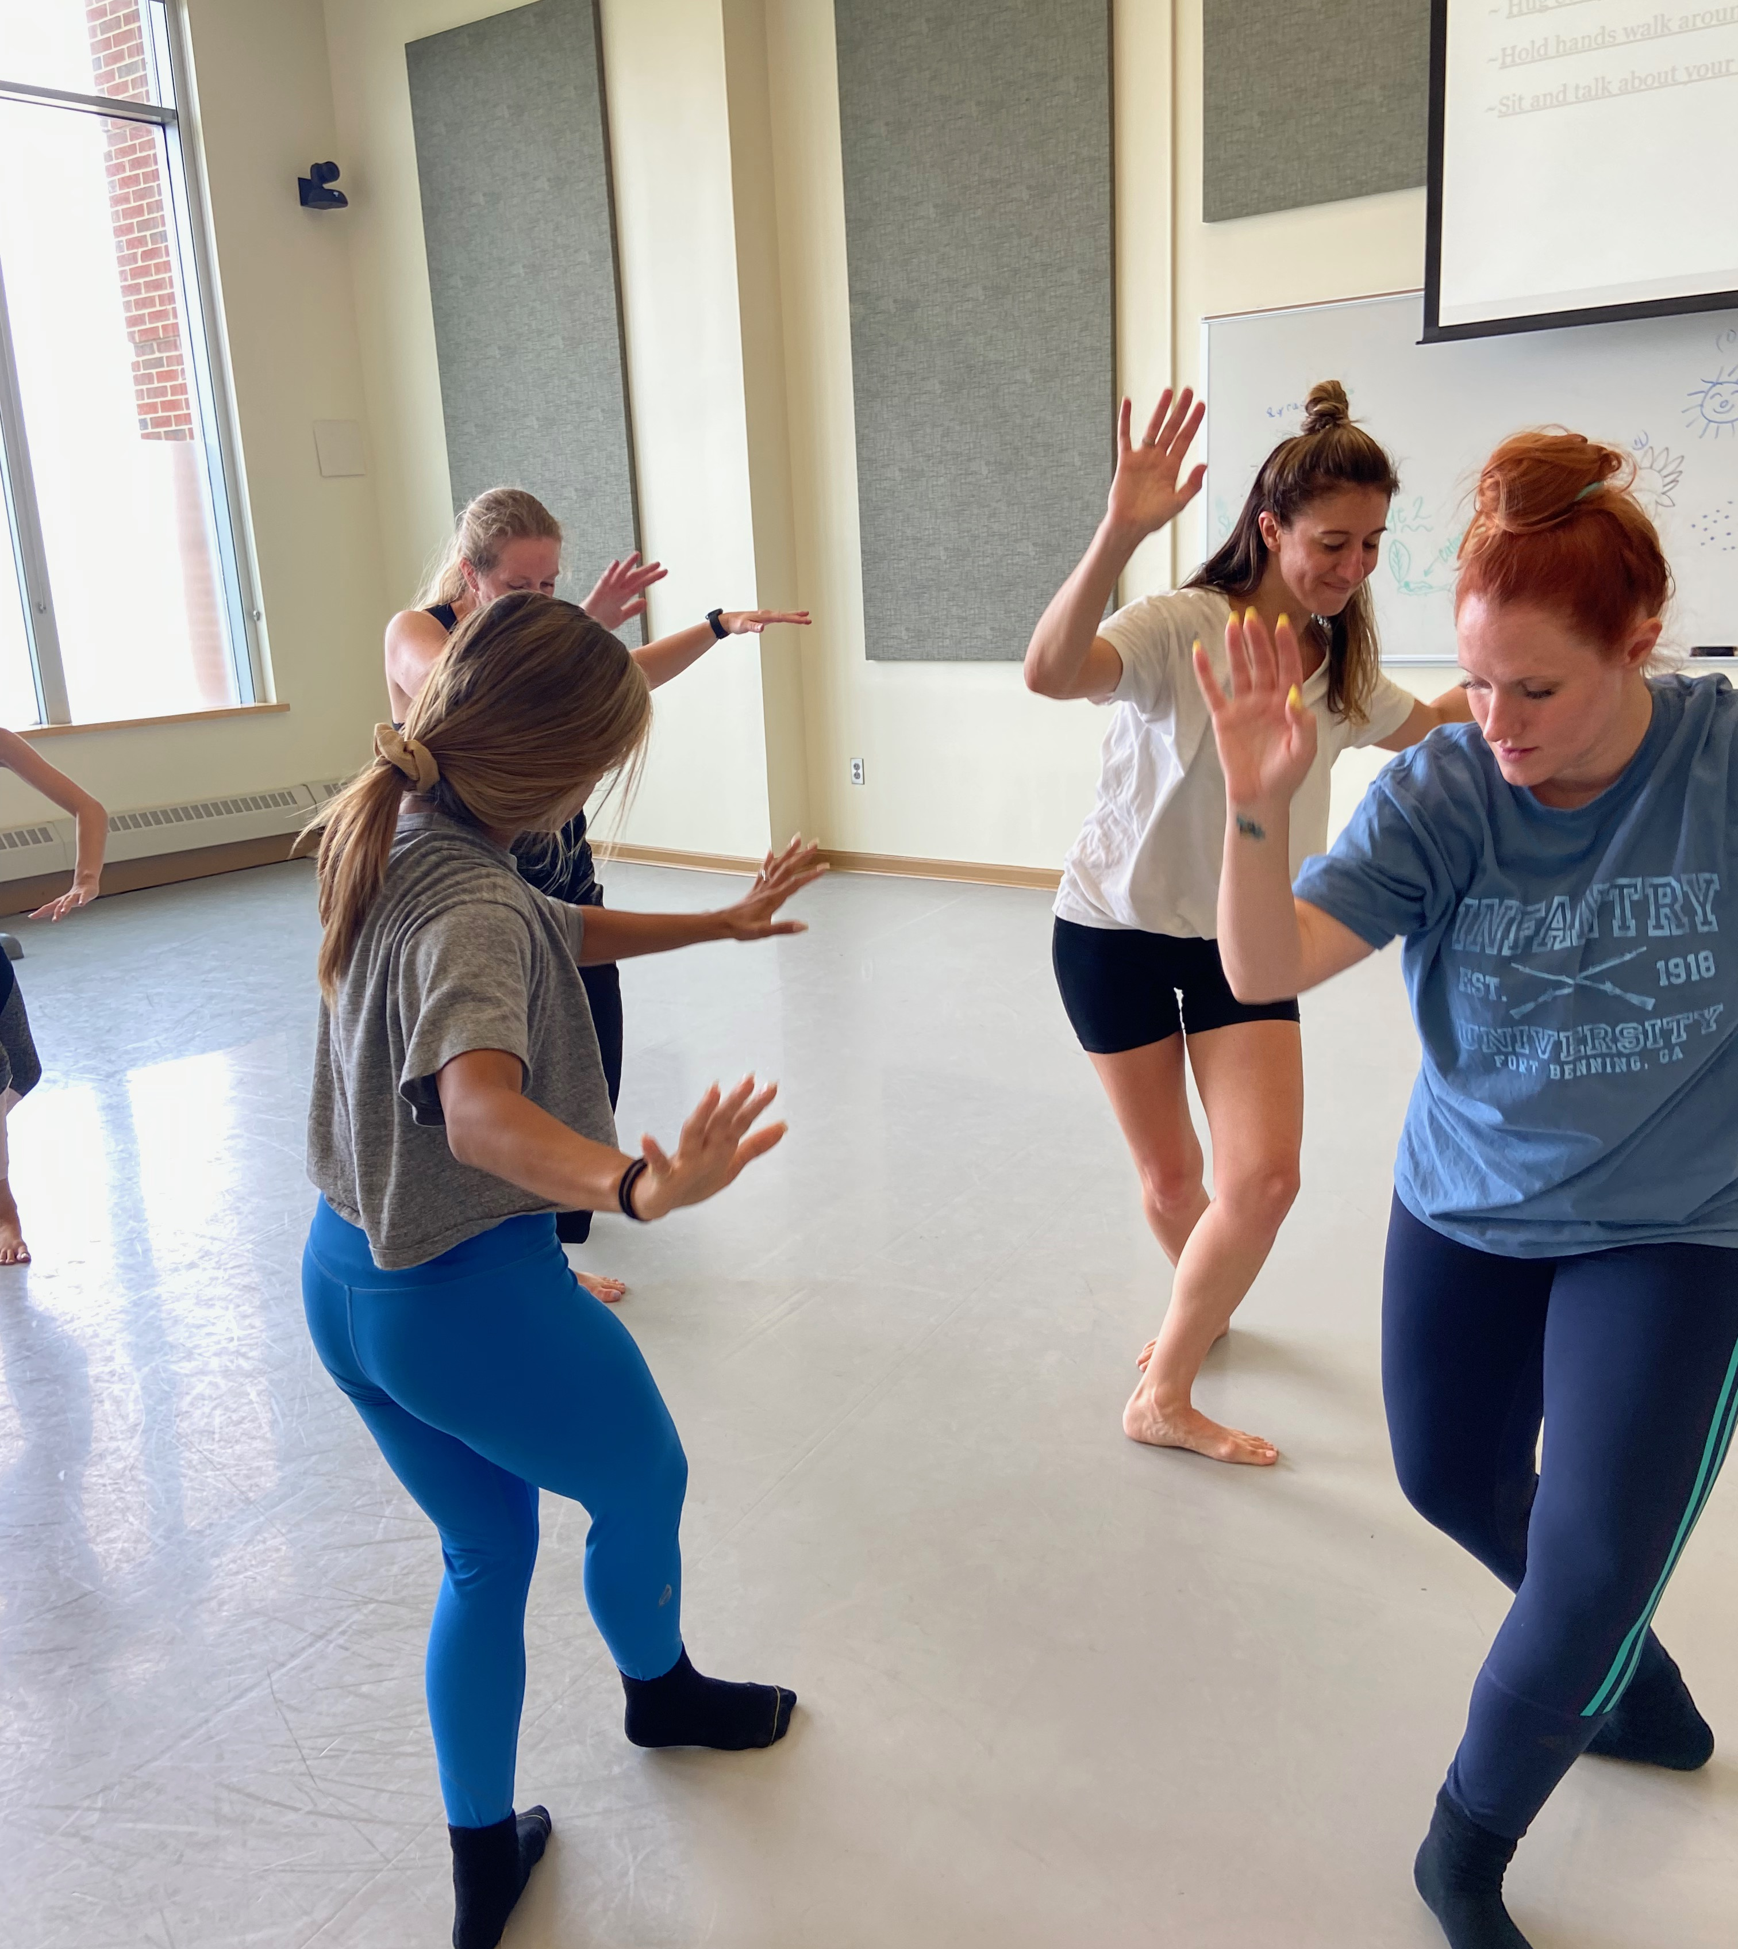
Requirements
Bachelor’s degree with a GPA of 3.0
Conditional admits with a GPA of 2.75
Prerequisites – Completion of a minimum of 20 hours of Introduction to Laban Movement Analysis by approval of program director.
Completed application, transcripts, resume, letters of recommendation, work samples and letter of intent required
International Students
ECE, IEE, IERF, SpanTran, or WES
TOEFL, PTE, IELTS or Duolingo
Notes:
No GRE scores are required.
A baccalaureate degree from a regionally accredited college or university.
A minimum undergraduate GPA of 3.00 (on a 4-point scale) is required for full admission to the program, and 2.75 is required for conditional admission. GPA calculations may be based upon the cumulative units or the last 60 units of the degree. See graduate admission policies for more information.
Teaching experience is preferred, but not required.
Prerequisite: Completion of a minimum of 20 hours of Introduction to Laban Movement Analysis by approval of program director.
An interview may be requested at the discretion of the master’s program dance faculty following initial admission screening.
Application Requirements
Submit an online application, application fee and official transcripts, along with:
current resume: a current professional resume
statement of intent: a detailed statement of intent of two to three, double-spaced pages demonstrating the applicant’s readiness for graduate level work and describing the following: background in arts and/or education and professional goals in seeking the degree
letters of recommendation: two (2) letters of recommendation (email addresses of recommenders must be entered on application)
work samples: samples of creative, teaching, or performance work

Slide 12
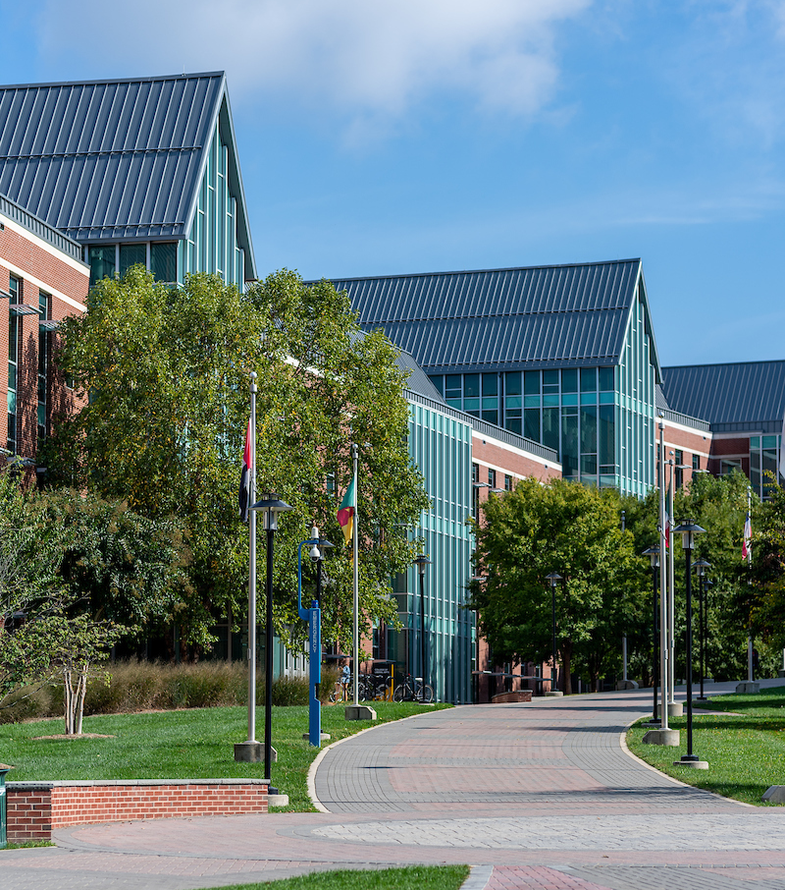
Tuition & Fees
In-State $702 per Credit
Out-of-State $1,270 per Credit
F1, J1 and B visa holders are considered out-of-state
https://www.towson.edu/student-university-billing/

Slide 13
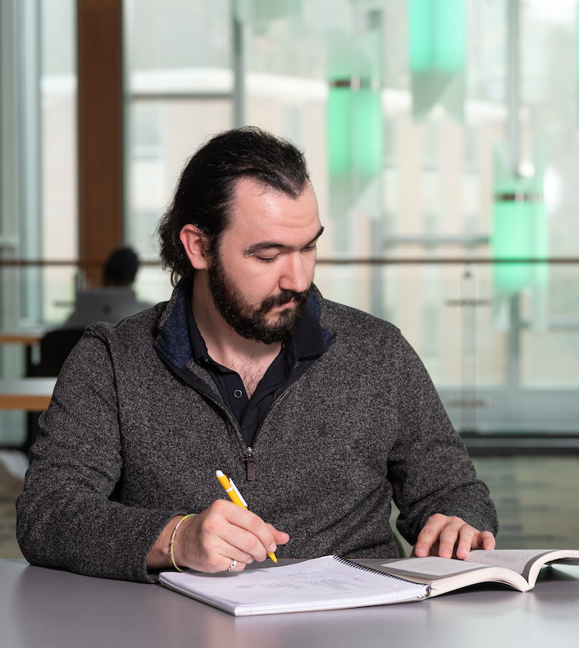
Financial Aid
Graduate Assistantships
Tuition remission + stipend
Each college awards a limited number annually
May impact eligibility for other types of aid
www.towson.edu/gradassistantships/

Slide 14

Financial Aid
Free Application for Federal Student Aid (FAFSA)
Application open now for 2025-2026 academic year
www.fafsa.ed.gov
TU school code: 002099

Slide 15
Financial Aid
Federal Direct Unsubsidized Loans
$20,500 for one academic year
Grad PLUS Loan
Eligibility determined by Cost of Attendance
Approval based on credit history
Alternate Loans
Private bank/lender
Apply directly with lender

Slide 16
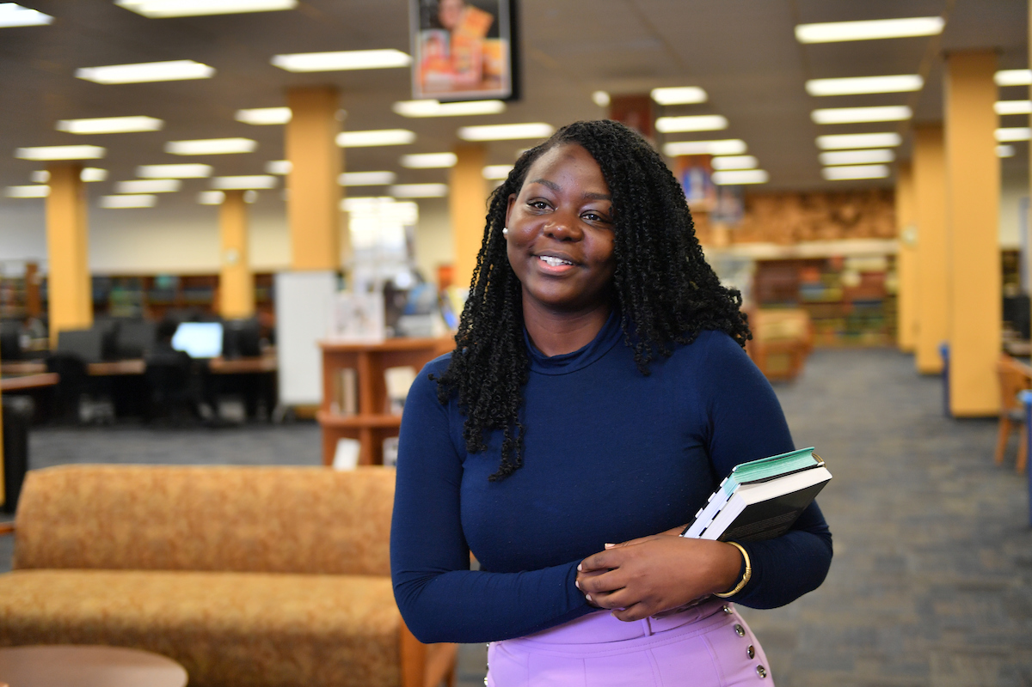
Financial Aid
Fellowships & Scholarships
Terminal Degree Fellowship Program
College-specific scholarships
Scholarship Seeker
Notes:
Scholarship seeker helps you to search for Undergraduate & Graduate Towson University departmental scholarships, TU Foundation scholarships, and Maryland State Scholarships offered to Maryland residents by the Maryland Higher Education Commission (MHEC).

Slide 17
STUDENT RESOURCES
Social Media
JOHNY COFFEE

Slide 18
Graduate Spotlight
What to expect as a Grad Student
Campus Resources
Housing Assistance
Tips for Success
Graduate Student Association
Notes:
The Graduate Student Association (GSA) hosts events through the academic year to build community. Additionally, the GSA represents the graduate student voice on committees across the campus.
Library, veterans center, accessibility and disability services

Slide 19
Questions?
Online Application
www.towson.edu/gradapply
Graduate Admissions
grad@towson.edu
Program Director
Jaye Knutson
jknutson@towson.edu
Financial Aid
finaid@towson.edu
Graduate Student Association
gsa@towson.edu

Slide 20
QuesQUESTIONS!

Slide 21
THANK YOU!
Social Media
JOHNY COFFEE

