Slide 1
Adjunct Information
Fall 2019
Computer and Information Sciences Department
Notes:
1

Slide 2
Department Admin
Sidd Kaza – Department Chair
skaza@Towson.edu 410-704-3701
Bob Hammell – Associate Chair
rhammell@Towson.edu 410-704-6050
Marcy Krawczyk – Administrative Assistant
mkrawczyk@Towson.edu 410-704-3788
Shannon Kreiner – Administrative Assistant
skreiner@towson.edu 410-704-5044
Heather Bohle – Student Services Coordinator
hbohle@Towson.edu 410-704-2757
Continued next page

Slide 3
Department Admin (contd)
Sam Houston – Computing Resources Director
shouston@Towson.edu 410-704-3177
Kyle Cummings – Lab Systems Administrator
jcummings@Towson.edu 410-704-2424
Greg Nikol – IT Lab Coordinator
gnikol@Towson.edu 410-704-3502

Slide 4
Resources
Provost Orientation site:
http://www.towson.edu/provost/academicresources/index.html
Adjunct Faculty Procedures & Resources
Classroom Resources
Faculty and Teaching Handbook
Policies

Slide 5
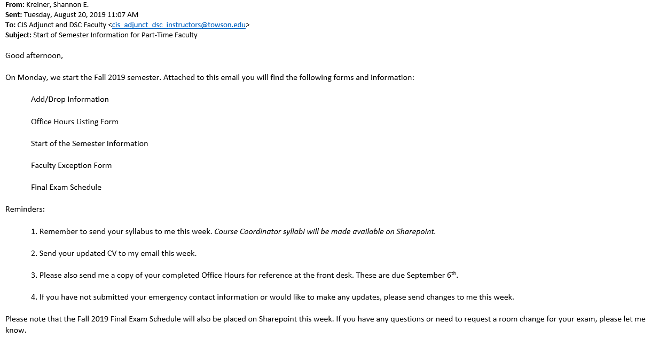
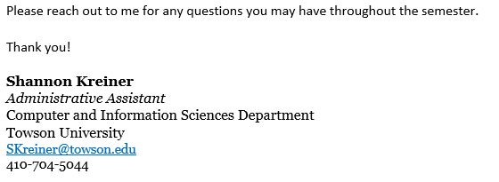
Resources
You should have received an email like this from Shannon …it contains useful forms and info.

Slide 6
Resources
Heather has also emailed another document entitled:
Fall 2019 – Important Semester Information - Adjuncts
It has a LOT of information in it. Please read!!
Phone numbers, repeat of department admin info, classroom procedures and general info, fire drill procedure, Blackboard instructions, using the grade roster

Slide 7
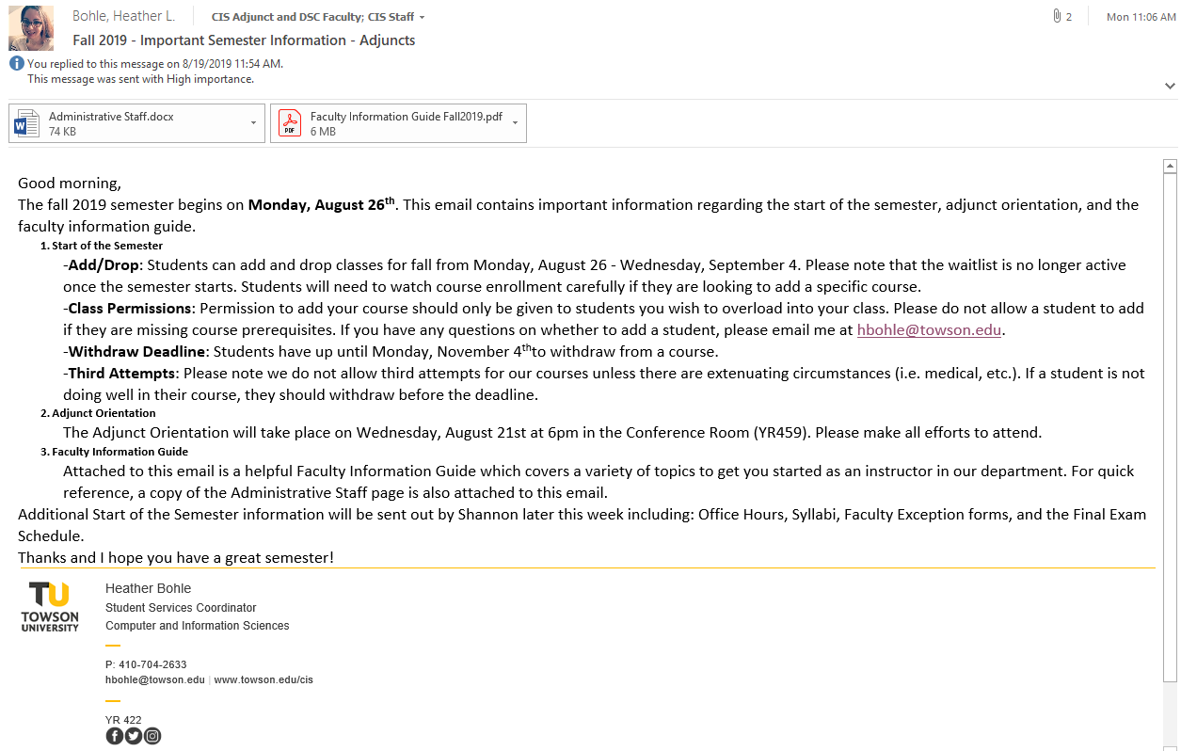
Resources

Slide 8
Start of Semester Info
Fall 2019
Add/Drop Period
Monday, August 26 –
Wednesday, September 4
Students must monitor class enrollments for openings and register online during the add/drop period.
Fri, 23 Aug: Option for students to add themselves to the waitlist will be disabled
Mon, 26 Aug: Waitlist process is turned off; students will no longer be enrolled from the waitlist

Slide 9
Start of Semester Info
Adding Classes
Students can do online registration through Towson Online Services until Sep 4
For special circumstances (class closed, etc.): send a note to Shannon with the students name, ID#, and class/section information with your permission.
In general, these special permissions are discouraged unless there is a compelling reason and it is a lower level class
Dropping Classes
Use Towson Online Services through the end of the Drop/Add period (Sep 4)
Last day to withdraw with a “W”: Monday, Nov 4

Slide 10
Start of Semester Info
Course Syllabi
Distribute; Discuss
Email from Shannon outlines minimum contents
Schedules & Office Hours
Use form attached to email from Shannon
Post; Send to Shannon for O:Drive as well
Classroom Changes
Must go through Shannon
Do not just move your classes to other rooms!

Slide 11
Class Assessment Suggestions
A comprehensive final exam (or final project) is typical
It is recommended that no single assessment count more than 35% of the entire course grade.
Frequent feedback to students is helpful!
Timely feedback is expected
Students should have received enough feedback by the withdrawal date to make an informed decision about staying in the class

Slide 12
Logistical Information
Copier code: 04020
Office space: YR 431, YR 432, YR 433
You will need to talk to Marcy to get a key (with a refundable $20 cash deposit)
You will have a mailbox in the copy room.
You may also need to see Sam to get magnetic card access to your classroom(s)

Slide 13
Email to All Students
Send notices via PeopleSoft class roster
Send email to entire class as follows:
Always 1 Last 2 digits of current year
1194COSC109003@towson.edu
Term:
1=Mini 3=Summer Course & Section
2= Spring 4=Fall without punctuation

Slide 14
Copying Material
Avoid extensive handouts when possible
Use Blackboard and/or e-mail materials as an alternative to hardcopies
Copy only material that can’t be posted (e.g., exams, quizzes)
Copy using both sides of the paper
Two ways to make copies
Department copier (code: 04020)
Printing Center in basement of YR Bldg (preferable)
Turn-around time typically < 24 hrs
Check with the Department Office for details
https://printcenter1.towson.edu/DSF/storefront.aspx?6xni2of2cF0jOQEeg7t/kGkVNOm4i/bSTf7s1LUQ4n6r2Uy0TwfTnTmpCfcDGC8W
Departmental code is 12830

Slide 15
Class Cancellation
If you have to cancel a class meeting for any reason:
Fill out a Faculty Exception Form (in the copy room)
Notify the Department (Shannon)
Preferably by phone
Shannon: 410-704-2633
Or by email
Notify your students of your absence, using e-mail methods as per previous slide. If you cc Shannon on this notice, you need not write a separate e-mail as indicated above.

Slide 16
General Tips
Feedback to students
Confidential
Timely: return graded tests and homework during the next session or no later than a week from the time it was collected
Self explanatory
Consider handing out detailed solutions
Answer e-mail promptly (use TU faculty e-mail account)
Set expectations early
Be available during office hours
Student unhappiness is often caused by misunderstood expectations or miscommunication
Observe scheduled class time
Encourage discussion and questions

Slide 17
General Tips
Avoid offending your students
Post final grades by the 72-hour deadline
Cheating: TU Faculty Handbook, Ch. 7
Faculty members shall make all reasonable efforts to prevent the occurrence of academic dishonesty through appropriate design and administration of assignments and examinations, careful safeguarding of course materials and examinations, and regular reassessment of evaluation procedures.
See Academic Integrity Policy
http://www.towson.edu/studentaffairs/policies/ (follow the “Student Academic Integrity Policy” link)

Slide 18
Other Useful Resources
Grades and Grading Policies: http://www.towson.edu/registrar/grades/policies.html
BlackBoard information: http://www.towson.edu/blackboard/facultyresources.asp

Slide 19
Other Useful Resources
Disability Support Services: http://www.towson.edu/dss/index.html
OTS Technology Orientation:
https://www.towson.edu/technology/facultystaff/support/technology-orientation.html
Provost’s site of academic resources:
http://www.towson.edu/provost/academicresources/index.html

Slide 20
Instructor Evaluation Process
As part of our ongoing process to ensure quality and consistent instruction we periodically schedule class visits for all tenure track and clinical faculty, lecturers, adjuncts, and other part-time faculty.
All new instructors teaching for the first time will be evaluated this term
An evaluator will be appointed by the department
The evaluator will contact you to coordinate the date/time
You and the department get a copy of the evaluation
For other faculty, there will be a “lottery”
Ensure each instructor is evaluated at least once every 3 years

Slide 21
Instructor Evaluation Process
Evaluations cover the following on a 1 – 5 scale:
Organization of lesson
Knowledge of course material
Clarity of presentation
Motivation of students
Student participation
Student rapport
Degree of helpfulness to students

Slide 22
Final Thoughts
Utilize the many resources that are available
Be responsive to students (and admin)
Check your email constantly – especially your faculty email
Don’t forget to check your physical mailboxes
Students are not the enemy
Provide opportunities to learn
Set expectations
Be firm and fair

Slide 23
Questions?

