Slide 1
Guidelines for Writing Effective Course Learning Outcomes
Bri Lauka (Director of Assessment)
February 2026

Slide 2
What is a learning outcome?
A Learning Outcome defines what a student should be able to demonstrate (knowledge, skills, or attitudes) at the end of a learning experience.
Learning Outcomes should inform the learning activities and assessment measures.
Learning Outcomes are student-focused rather than instructor-centered.
Goals
“Develop critical thinking skills”
“Increase belonging”
Learning Outcomes (output)
What the learners should demonstrate
Learning Activity
Assessment
Pedagogy
Objectives (input)
Measuring student achievement of the learning outcomes
Using results to improve curriculum and pedagogy

Slide 3
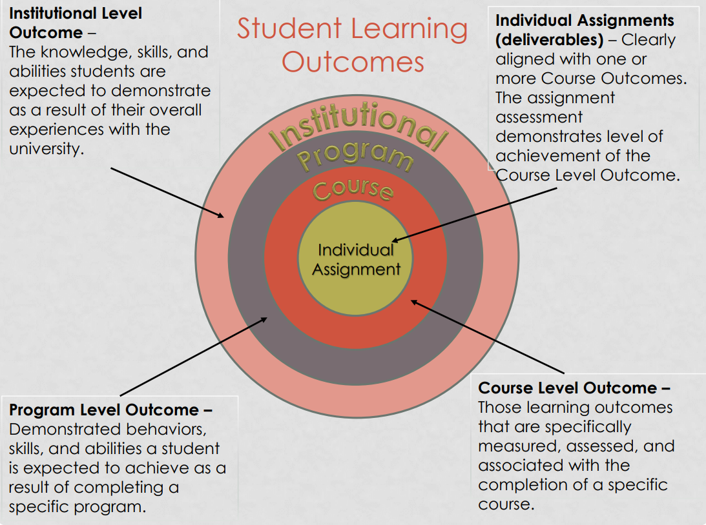
Using Curriculum Mapping to Improve Learning, slide 19
ISLO
PLO
CLO
Assessment Measure

Slide 4
Structure of a Learning Outcome
An Action Verb tells you how learning should be demonstrated
A Learning Statement explain the details of what learning will be demonstrated – the thing you want them to learn, and expected standards, if applicable (e.g., required level of achievement)
Students/Learners will…
(action verb) + (learning statement/object + standard).
Sample Learning Objectives - Eberly Center - Carnegie Mellon University
Academic Assessment - Office of the Provost | Montana State University
Course Objectives & Learning Outcomes | Course Design | Teaching Guides | Teaching Commons | DePaul University, Chicago
Learning Objectives Builder | Teach Online

Slide 5
Standard vs. Growth
Learning Outcomes can be written in two ways:
Absolute Standard
Example: Students will improve in their ability to articulate how their values inform their creative practice.
Typically assessed once as a summative measure.
Value Added
Example: Students will articulate how their values inform their creative practice.
Must measure achievement at least two times to establish a baseline and assess change/growth over time.
ISLOs and PLOs are meant to articulate the characteristics of a graduate or a professional/practitioner and are thus typically written as absolute standards.
CLOs are often a mixture of absolute standards and value-added achievement.

Slide 6
SLOs should have S.M.A.R.T. attributes
ISLO
PLO
CLO
Assessment Measure
Specific & Student-Focused – Statements of learning are concise and well defined in describing what students will be able to do.
Measurable – Uses action / measurable verbs to describe what the student will be able to demonstrate.
Attainable – Learners will have the pre-requisite knowledge and skills to achieve the stated learning objectives.
Relevant – Stated skills or knowledge are appropriate for the type of learning experience and align with program/institutional outcomes.
Transparent – Clearly explains what skills students will practice or knowledge they will gain.

Slide 7
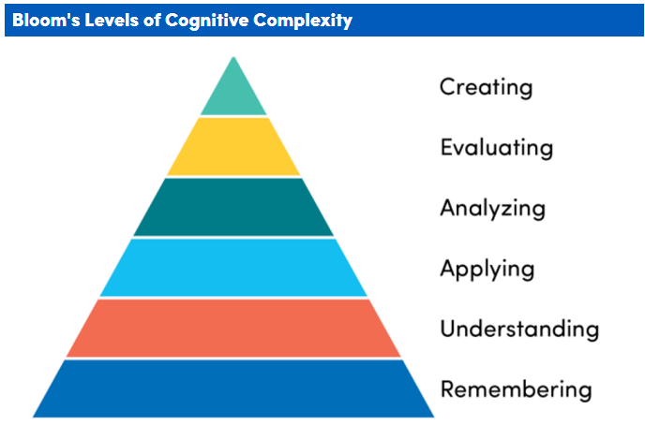
Bloom's Revised Taxonomy - Office of Curriculum, Assessment and Teaching Transformation - University at Buffalo
Higher levels are often more complex. While higher levels may be more difficult, this is not always the case. For example, the complexity or difficulty of a student creating a song may be low (e.g., sing any melody) or high (e.g., incorporate a full orchestra).
Levels build off each other. In order to analyze content, students need to know and understand the parts or there is nothing to analyze. While levels often build off each other, students can be introduced to, and complete, levels at higher tasks earlier. For example, asking students to cook a souffle first, and then analyze what worked and what went wrong to better understand the chemistry of cooking uses several levels together.
Variety of levels. An entry-level course may require students to mainly remember, understand and apply concepts, while a higher-level course might focus more on evaluation and creation.
Scaffolding. Beginning students can practice higher levels of complexity with appropriate scaffolding. For example, when asking students to create a short story you might limit page length, number of characters, location etc.

Slide 8
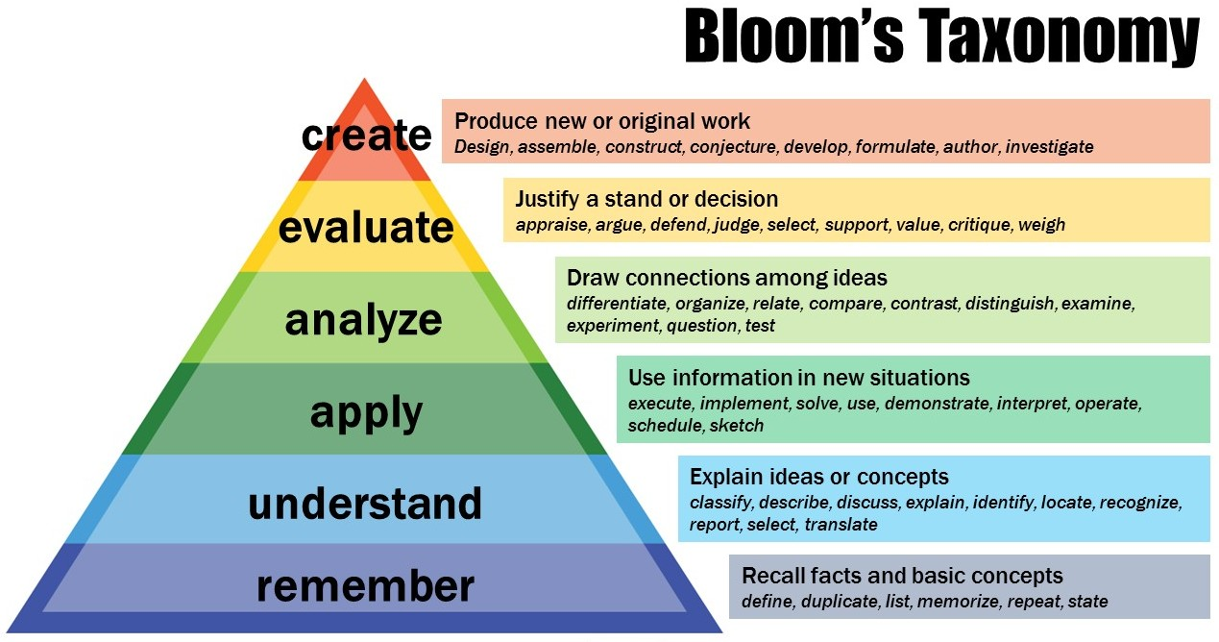
Bloom’s Taxonomy

Slide 9
Medicine Wheel Framework
An alternative framework for creating learning outcomes to support Indigenous students:
Includes Spiritual domain to reflect a balance in learning and Indigenous worldviews
Honouring- learning not based on material/physical things
Valued- building relationships based on qualities related to welfare of human spirit
Connected- sense of belonging/building relationships with classroom, community, etc.
Empowered- feel supported in environment that encourages strength and confidence
Self-Actualize- unique entity in group, become what one is meant to be
Non-Indigenous must consider instructor/learner roles and the difference between spirituality and religion
Marcella LaFever (2016) Switching from Bloom to the Medicine Wheel: creating learning outcomes that support Indigenous ways of knowing in post-secondary education, Intercultural Education, 27:5, 409-424

Slide 10
Things to avoid
Compound predicates and objects
“Identify, consider, and critique perspectives, sources, and conclusions in the field of social science.”
Ambiguous, passive, or difficult to measure verbs
“Understand...” “Reflect on…” “Learn about….”
Outcomes not related to learning, or distal outcomes
“Students will gain employment in a relevant field.”
Outcomes that require complex measures
“Increase awareness of…” “Improve understanding of...”
Writing outcomes primarily for non-student audiences (i.e., esoteric or academic)
“Demonstrate critical perspective on the social, political, and philosophical significance of hip-hop as an expression of US national identity in light of its provenance as a historically African-American art form.”

Slide 11
Revising CLOs
Understand the myriad forces that shape cognitive development (biology, experience, environment), and how they impact cognitive function (e.g., improvement vs decline).
Demonstrate critical perspective on the social, political, and philosophical significance of hip-hop as an expression of US national identity in light of its provenance as a historically African-American art form.
Articulate how myriad forces shape cognitive development and impact cognitive function.
Explain the social and political significance of hip-hop as an expression of US national identity and a historically African-American art form.
Is it…
Specific & Student-Focused?
Measurable?
Attainable?
Relevant?
Transparent?

Slide 12
Example CLOs
At the completion of this course, students will be able to….
Evaluate statistical claims in the popular press.
Describe the potential impact of specific ethical conflicts on research findings.
Determine the cost benefits and shortcomings of various cash management strategies.
Articulate the reasons behind their design decisions.
Predict the appearance and motion of visible celestial objects.
Formulate scientific questions about the motion of visible celestial objects
Select and integrate information from various sources, including electronic and print resources, community resources, and personally collected data, to answer the questions chosen.
Communicate scientific ideas, procedures, results, and conclusions using appropriate SI units, language, and formats.
Analyze the relationship between evidence and conclusions, detecting assumptions and critically evaluating claims.
Perform or present a complex body of information in both one-on-one and group contexts.
Design standards-based instruction that integrates musicianship, music literacy, creativity, and developmentally appropriate pedagogy.
Integrate evidence-based practice (EBP) and principles of patient safety while incorporating individual values into the care of diverse populations.
Critique current practices in supporting and measuring cognitive processes and their development.

Slide 13
Transparency in Learning and Teaching (TILT)
TILT is an evidenced-based framework designed to enhance student learning and engagement by making the purpose, tasks, and criteria of assignments explicitly clear.
Transparent Purpose (Outcomes): Explain the specific skills they will practice, knowledge they will gain, and how they might use that learning after college
Transparent Task: Describe the learning activity, including steps they will take to complete the work and steps to avoid.
Transparent Criteria for Evaluation: Share in advance how to judge the effectiveness of their labor on work that is underway, and share multiple examples of what successful completed work might look like
Winkelmes, M. (2023). Introduction to Transparency in Learning and Teaching. Perspectives In Learning, 20 (1). Retrieved from https://csuepress.columbusstate.edu/pil/vol20/iss1/2

Slide 14
Mind your measures…
Think about how students can effectively demonstrate their learning to help guide your choice of action verb.
Design teaching and class activities to help students achieve these outcomes.
Ensure your summative assignments/assessments match the level of complexity for the action verb.
Build in formative assessment activities to help students practice the skills as described in the outcomes.
Analyze your students’ learning assessment results to consider adjustments to the course design or assignments/measures used.

Slide 15
Resources
TU Resources
Faculty Academic Center of Excellence at Towson
Office of Assessment
External Resources
Course Objectives & Learning Outcomes | Course Design | Teaching Guides | Teaching Commons | DePaul University, Chicago
Learning Objectives Builder | Teach Online
Using Curriculum Mapping to Improve Learning
Course Development Resources - Office of the Provost | Montana State University
Taxonomies
Frameworks & Taxonomies of Learning | Course Design | Teaching Guides | Teaching Commons | DePaul University, Chicago
Bloom's Revised Taxonomy - Office of Curriculum, Assessment and Teaching Transformation - University at Buffalo
Assessment Resources

