Slide 1


Slide 3

Notes:
All colleges are essentially the same.
So if we change, we can change all of us.

Slide 4
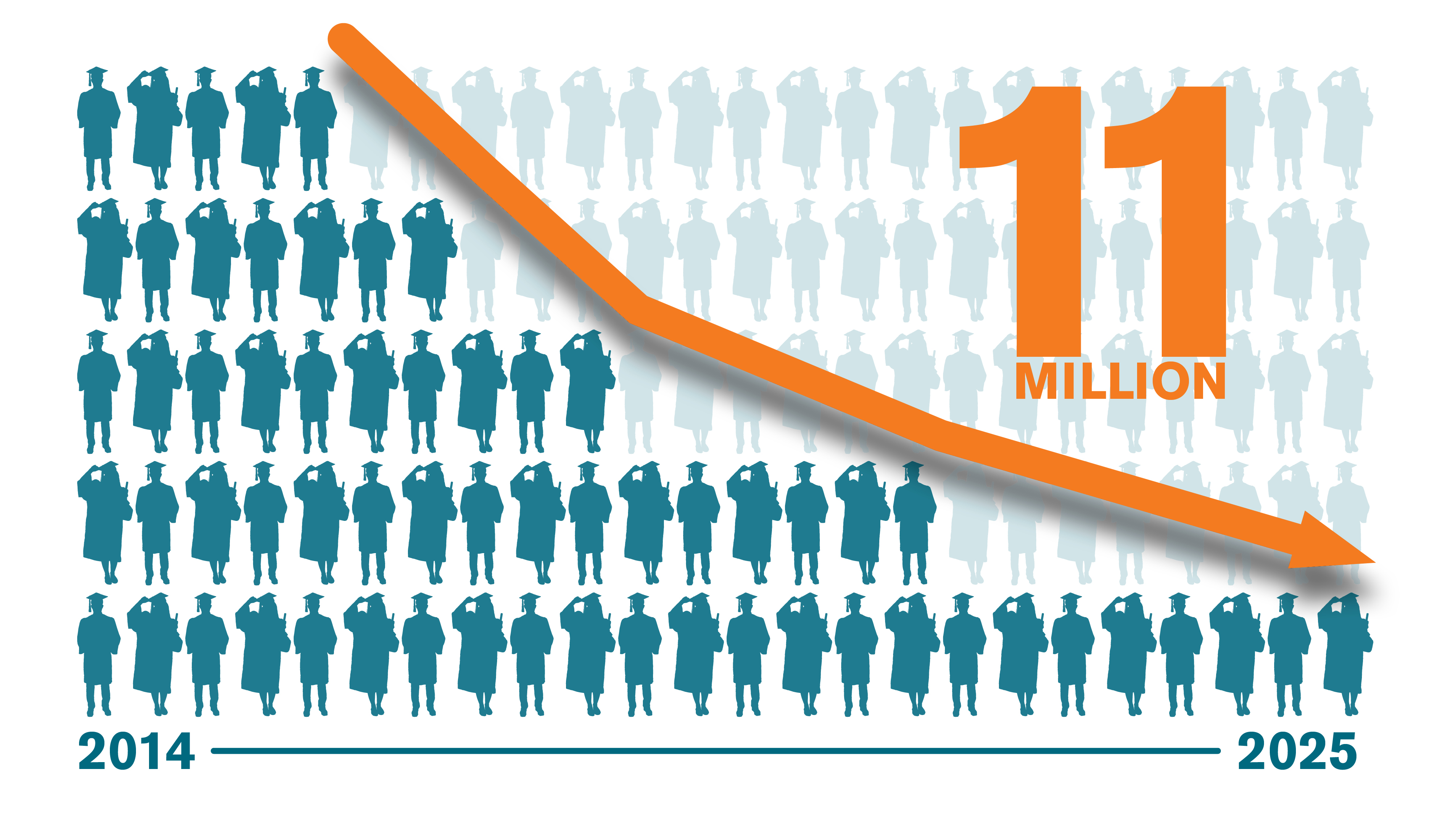
Notes:
Need to produce more degrees.
Less students will be coming between 18-22 (birth rates are lower)
We need to adapt our institutions to meet the needs of adult learners and “some college/no degree”

Slide 5
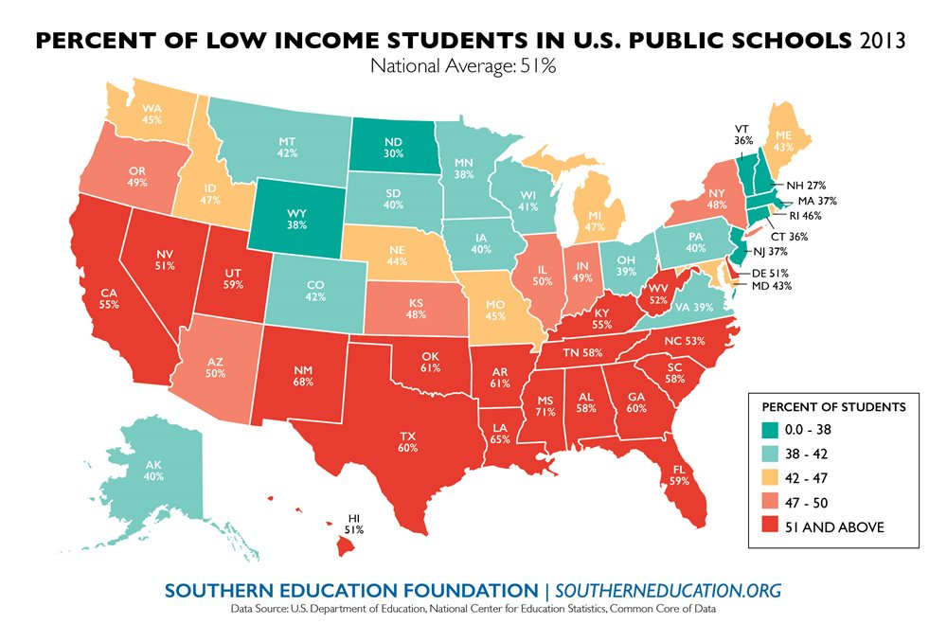

Slide 6
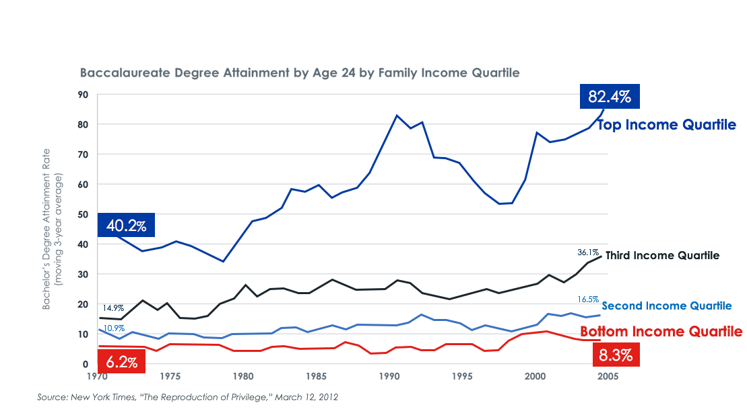

Slide 7
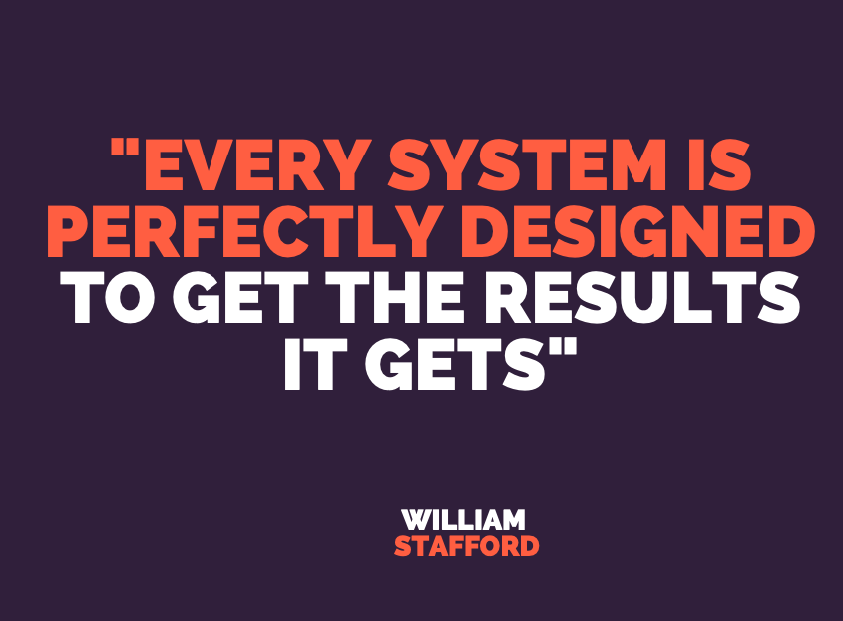

Slide 8
Notes:
Example: UIA
Stretch break.

Slide 10
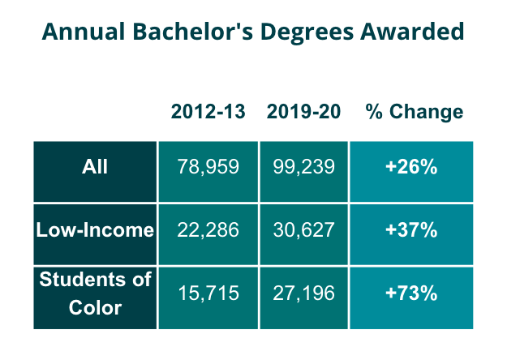


Slide 11
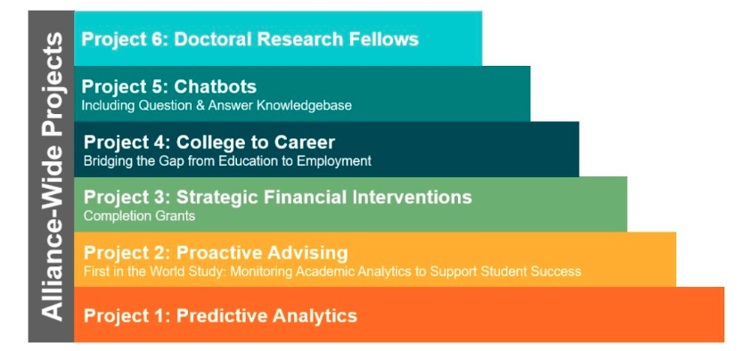

Slide 12
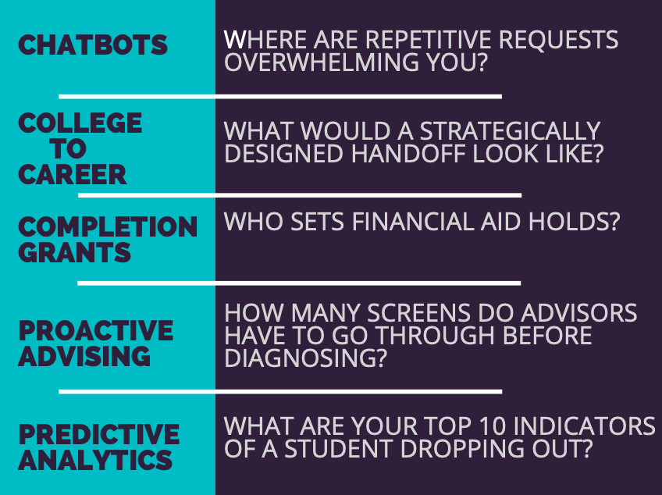

Slide 13


Slide 14
Notes:
Lack of intentional capacity has impacted our ability to innovate over time.
Retired. 49 is one example,
General rule of thumb: if you are asking a campus to do something more, you nee to be assured where the time and energy are coming from.
If you don’t know the answer: the answer is: they won’t give it proper attention.

Slide 15

Notes:
Trying to convince colleagues to do what you think

Slide 16
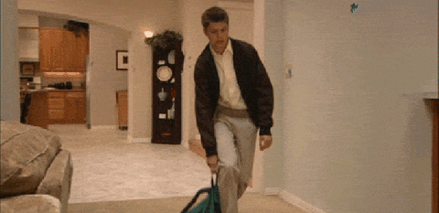
Notes:
Meetings that should be emails

Slide 17

Notes:
Too many emails

Slide 18
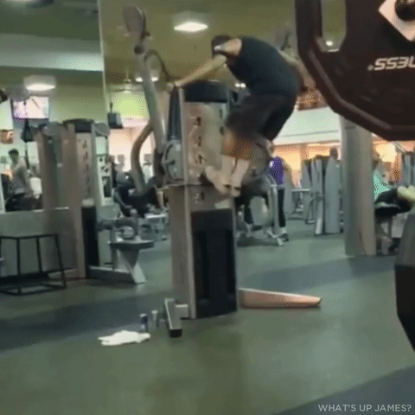
Notes:
You need a plan

Slide 19
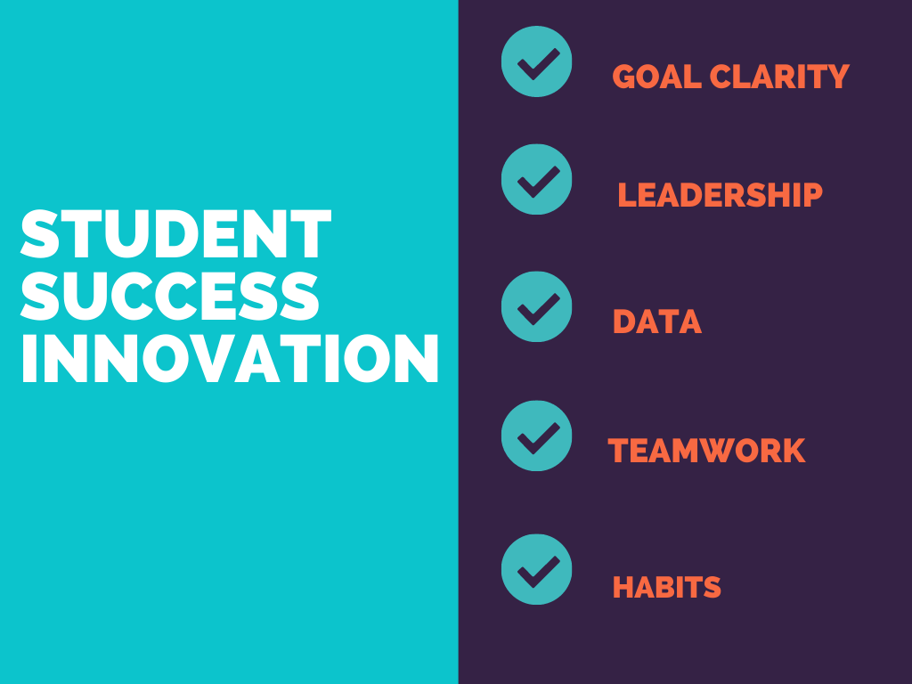

Slide 20


Slide 21
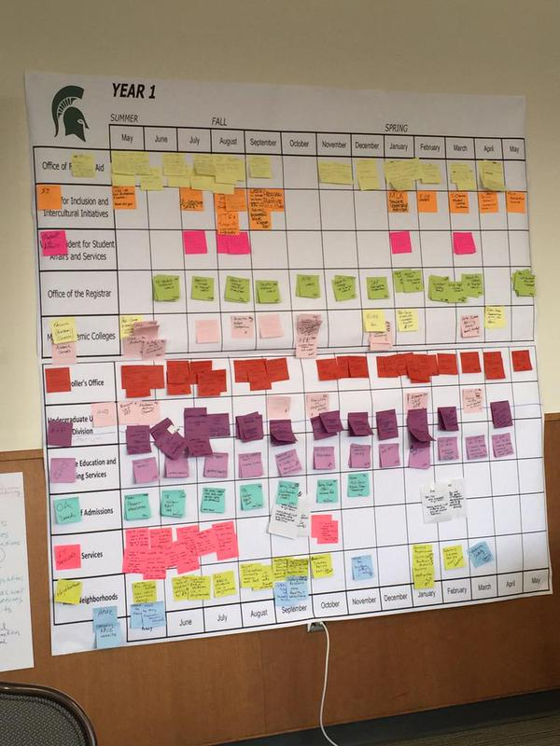
Notes:
Simple investments that create support for campus redesign work is needed.

Slide 22
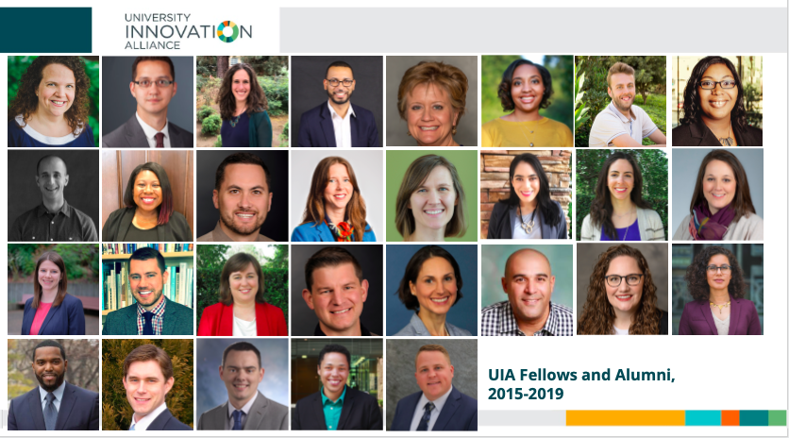
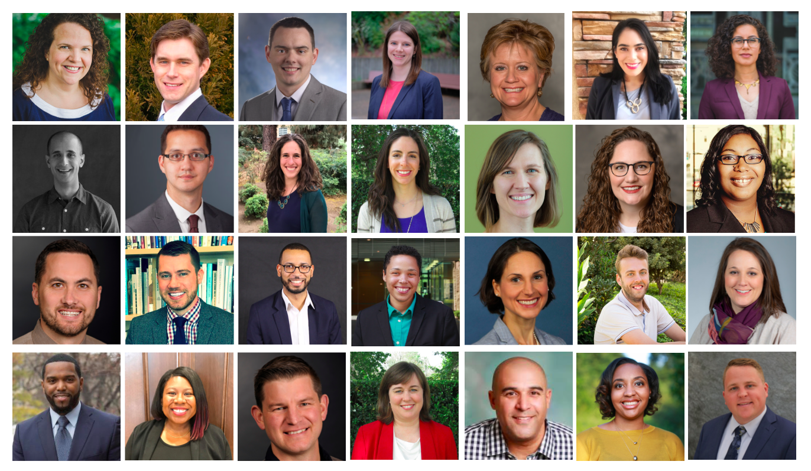
Notes:
Innovation can come from anywhere

Slide 23
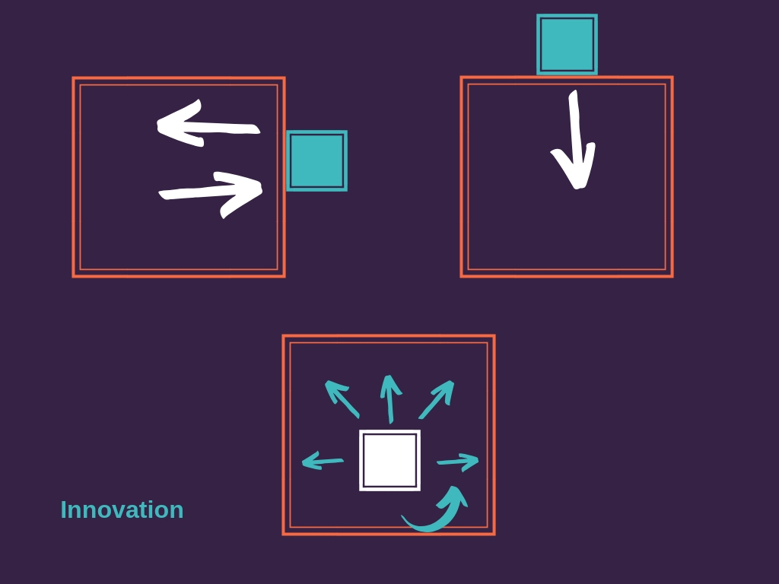

Slide 24
Notes:
Where did your campus get your last 3 new ideas?
How can you set yourself up for more?

Slide 25
Notes:
2 minutes:
Think of one thing that didn’t work on your campus.
How did you treat it?
Turn and talk

Slide 26
Notes:
What institutional habits might help you weigh in on your work and make progress?

Slide 28
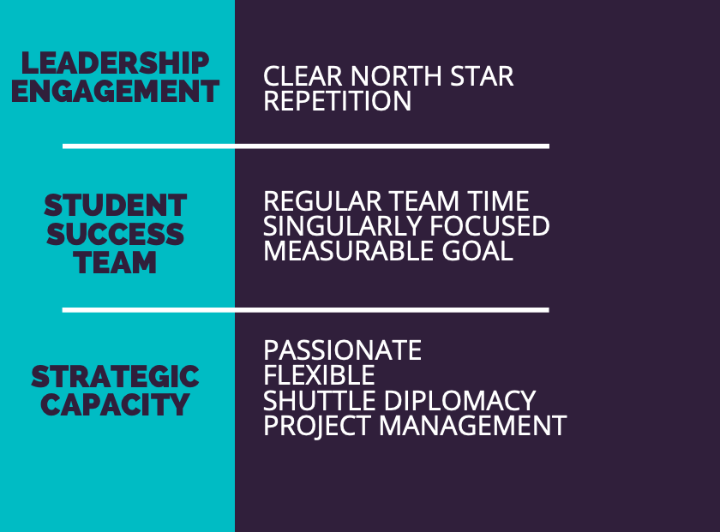

Slide 29


Slide 30
